Slide 1





Slide 2

Absa Investments
South African Transport Sector
Simphiwe Letlojane| Actuary (FASSA, CERA)
Head: Security Investments
April 2026

Slide 3
01
Geopolitics

Slide 4
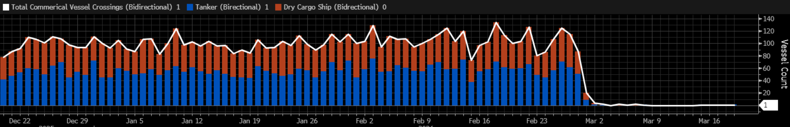
Strait of Hormuz Traffic
Strait of Hormuz commercial vessel crossings (rolling 24 hour vessel count)
Source: Bloomberg, 19 March 2026

Slide 5
SA Fuel Oil Imports
SA imports of petroleum oil (refined & crude)
Source: Absa Investments, International Trade Center, April 2026

Slide 6
SA Fuel Oil Imports
SA imports: Crude (2024)
SA imports: Refined products (2024)
Note: Excluding “Other” category
Source: Absa Investments, The Observatory of Economic Complexity (OEC), April 2026

Slide 7
April fuel price impact in SA
Fuel prices were set to increase by R5.26 per litre for petrol, and R9.49 per litre for diesel in April . To curb the impacts on consumers, the Minister of Finance announced a temporary R3.00 reduction in general fuel levies. The relief is set to expire on 5 May 2026, but will be re-evaluated for May and June
If the relief remains, expected May increases are around R3.00 for petrol and R9.00 for diesel.
2026 Monthly Fuel Prices
Source: Absa Investments, Automobile Association of South Africa, April 2026

Slide 8
Global Oil Scenarios – Geopolitical Risks
 | Bear case (severe escalation, prolonged war with material impact on supply) | Base case (conflict contained and no sustained supply shock) | Bull case (rapid de-escalation and no material supply shock)
Oil prices | Significant supply chain and production disruption. Oil prices sustained above $100 | Temporary spike in oil prices, with subsequent recovery when supply normalizes | Prices rapidly revert to normalized levels
Global inflation | Resurgent inflation on the back of higher energy prices and fuel costs | Short-lived inflation uptick followed by subsequent normalization | No material impact, global inflation continues to trend lower
Global interest rates | Global central banks keep interest rates restrictive | Monetary policy pathway largely unchanged but cuts potentially pushed out further | No change in monetary policy pathway, projections for further cuts remains intact
Economic growth | Slower economic growth across the globe, with large oil importers (China/ Europe) seeing the largest impact | Modest, short-term impact on growth | Growth expectations recover as uncertainty dissipates
Markets | Risk-off sentiments trigger selloff in equities, energy and defense sectors outperform. Emerging markets under perform. | Markets remain volatile as oil prices recover, but start to see broad based market recovery | As geopolitical risks fade, equity markets rebound, rotation back into longer duration sectors
Source: Absa Investments, March 2026

Slide 9
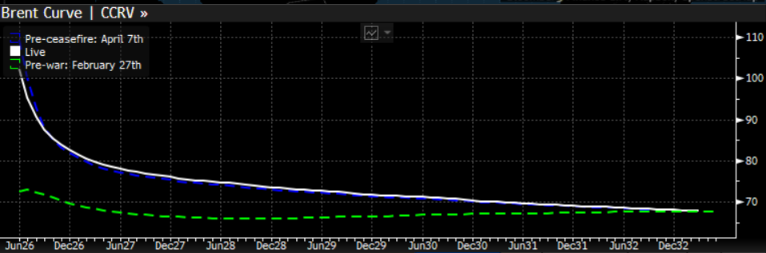
Global Oil Prices
Brent crude price
Brent crude forward price curve
Source: Bloomberg, 11 April 2026
Source: LSEG, 22 April 2026

Slide 10
02
Global Economy

Slide 11
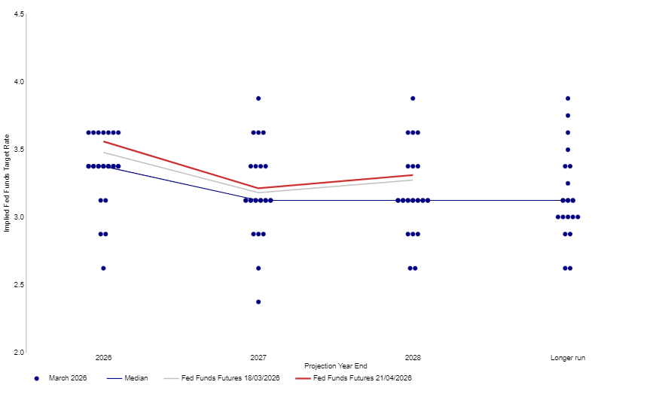
Global Interest Rates & Inflation
US, UK, Eurozone and China inflation
US Fed DotPlot
US Fed, BoE, ECB and PBoC interest rates
Source: LSEG Datastream, 22 April 2026

Slide 12
Global Economic Growth
Source: LSEG Datastream, 22 April 2026

Slide 13
SA Inflation and Interest Rates
SA inflation and repo rate
SA forward rate agreement markets
Source: LSEG Datastream, 22 April 2026
Source: LSEG Datastream, Absa Investments, 22 April 2026

Slide 14
SA Economic Growth
Economic growth by sector
Economic growth by expenditure
Source: Stats SA, Absa Investments, 02 April 2026
Source: LSEG Datastream, Absa Investments, 02 April 2026

Slide 15
Economic Forecasts
 | 2021 | 2022 | 2023 | 2024 | 2025 | 2026F | 2027F | 2028F
Global GDP | 6,6% | 3,8% | 3,5% | 3,3% | 3,3% | 3,0% | 3,1% | 3,2%
Developed Economies GDP | 6,1% | 3,1% | 1,8% | 1,9% | 1,8% | 1,8% | 1,8% | 1,9%
Emerging Economies GDP | 6,0% | 3,9% |  | 4,6% | 4,6% | 4,4% | 4,2% | 4,2%
USA
GDP | 6,2% | 2,5% | 2,9% | 2,8% | 2,1% | 2,2% | 2,0% | 2,1%
Unemployment | 5,4% | 3,6% | 3,6% | 4,0% | 4,3% | 4,5% | 4,3% | 4,3%
Inflation | 4,7% | 8,0% | 4,1% | 3,0% | 2,7% | 3,1% | 2,5% | 2,4%
China
GDP | 8,4% | 3,1% | 5,4% | 5,0% | 5,0% | 4,6% | 4,4% | 4,3%
Unemployment | 5,1% | 5,6% | 5,2% | 5,1% | 5,2% | 5,1% | 5,1% | 5,0%
Inflation | 0,9% | 2,0% | 0,2% | 0,2% | 0,1% | 0,9% | 1,0% | 1,5%
UK
GDP | 9,5% | 5,3% | 0,3% | 1,1% | 1,4% | 0,8% | 1,2% | 1,4%
Unemployment | 4,6% | 3,8% | 4,1% | 4,3% | 4,8% | 5,3% | 5,2% | 5,0%
Inflation | 2,6% | 9,1% | 7,4% | 2,5% | 3,4% | 2,9% | 2,4% | 2,0%
Eurozone
GDP | 6,3% | 3,6% | 0,4% | 0,9% | 1,4% | 1,1% | 1,4% | 1,5%
Unemployment | 7,8% | 6,8% | 6,5% | 6,3% | 6,3% | 6,2% | 6,1% | 5,9%
Inflation | 2,6% | 8,4% | 5,5% | 2,4% | 2,1% | 2,4% | 2,0% | 2,1%
South Africa
GDP | 5,5% | 2,1% | 0,8% | 0,5% | 1,1% | 1,9%** | 2,1%** | 2,2%**
Unemployment | 34,3% | 33,5% | 32,4% | 32,6% | 32,4% | 32,3%** | 32,5%** | 32,7%**
Inflation | 4,6% | 6,9% | 5,9% | 4,4% | 3,2% | 3,2%** | 3,5%** | 3,2%**
Source: Bloomberg, Absa Research, Absa Investments, April 2026
*expected, Note: South Africa expectations are from Absa Research, the rest are Bloomberg consensus expectations
** as at 31 January 2026

Slide 16
03
South African Transport

Slide 17
SA Vehicle Exports
Annual vehicle exports
SA vehicle export destinations 2025 (% of total vehicle exports)
Source: International Trade Centre, Absa Investments, April 2026

Slide 18
Transport in the South African Economy
Annual GDP growth by sector (2021-2025)
Source: Statistics South Africa (Stats SA), Absa Investments, April 2026

Slide 19
Transport in the South African Economy
GDP growth by sector over the past 20 years
Source: Statistics South Africa (Stats SA), Absa Investments, April 2026

Slide 20
Transport in the South African Economy
SA Q4 2025 GDP breakdown by sector
SA Q4 2025 employment by Sector
Unemployment rate and total employed by transport
Source: Statistics South Africa (Stats SA), Absa Investments, April 2026

Slide 21
Income – Freight Transport
Income by commodity type (January 2026)
Total income
Note: Excluding “Other” category
Rail vs Road freight transport
Source: Statistics South Africa – Land Transport Survey, Absa Investments, April 2026

Slide 22
Income – Passenger Transport
Total income
Rail vs Road passenger transport
Source: Statistics South Africa – Land Transport Survey, Absa Investments, April 2026

Slide 23
Transnet Recent Developments
Transnet has improved performance but continues to fall short of operational and financial target. The company remains unprofitable, with its financial position fragile due to rising debt levels and insufficient cash. However, the last year saw it narrowing its losses.
  Majority of improvements are from heavy reliance on government support, with Transnet being one of the largest borrowers
  Turning around is central to improving South Africa’s economic experience, with needs for stable performance of rails & ports, and expansion of export capacity
Operational improvements
  Core focus is to implement its recovery plan. Priorities included stabilising operations, accelerating the return to service of locomotives and strengthening security.
  April 2025: Adopted a new strategy to address the operational, financial and structural challenges that have constrained performance and adapt to the evolving logistics regulatory environment.
  Transnet has received R1.3 billion for the Cape Town Container Terminal Expansion (Phase 2B) Project
  Transnet has signed a 25-year agreement with a private partner to upgrade and develop the Durban Container Terminal Pier 2
  Seven of the 11 private train operating companies allocated slots on the freight network will start operations in the first quarter of 2027
Funding and Investment
Government extended additional guarantees of R145.8 billion in 2025/26 to enable Transnet to redeem maturing loans and support capital investment
Other approved government funding for expansion include
  North corridor funding of R6.7Bn
  Iron ore corridor funding of R3.4Bn
  Durban Container terminal funding of R4.59Bn
Over the next three years, Transnet plans to invest R76.6 billion to improve the efficiency and reliability of the logistics value chain. This investment will support greater private-sector participation across the iron ore and manganese, coal and chrome, and container and automotive intermodal corridors

Slide 24
04
National Budget

Slide 25
2026 National Budget
Primary and consolidated budget deficit
Government debt-to-GDP
Source: Absa Investments, National Treasury, 25 February 2026

Slide 26
2026 National Budget
Composition of R1 trillion infrastructure spend over the next 3 years
Changes in National Treasury GDP growth projections
Source: Absa Investments, National Treasury, 25 February 2026

Slide 27
05
Houseview

Slide 28
Global Market KPIs
Key
Level | Weak | Moderate | Good
KPI’s | Deteriorating | Stable | Improving | Score
US Inflation |  |  |  | 2 | Moderate and deteriorating
Monetary policy |  |  |  | 3 | Moderate and stable
Consumer spending |  |  |  | 2 | Moderate and stable, but starting to deteriorate
Unemployment |  |  |  | 4 | Good and stable, but starting to deteriorate
Confidence |  |  |  | 2 | Moderate and deteriorating
Economic growth |  |  |  | 3 | Moderate and stable, but starting to deteriorate
Government spending |  |  |  | 4 | Good and stable, but starting to deteriorate
Tax |  |  |  | 3 | Moderate and stable
Global oil prices (inverse) |  |  |  | 1 | Weak and deteriorating
Geopolitical tension & trade |  |  |  | 1 | Weak and deteriorating
Earnings |  |  |  | 4 | Good and stable, may deteriorate
Valuations |  |  |  | 2 | Weak (stretched) and stable

Slide 29
Local Market KPIs
Key
Level | Weak | Moderate | Good
KPI’s | Deteriorating | Stable | Improving | Score
Inflation |  |  |  | 3 | Good and deteriorating
Monetary policy |  |  |  | 3 | Moderate and stable
Consumer spending |  |  |  | 3 | Moderate and stable, may deteriorate
Unemployment |  |  |  | 2 | Weak and stable
Confidence |  |  |  | 3 | Moderate and stable
Energy supply |  |  |  | 4 | Good and stable
Water infrastructure |  |  |  | 2 | Weak and stable, but starting to improve
Logistics (ports, railway) |  |  |  | 4 | Moderate and improving
Geopolitical tension & trade |  |  |  | 1 | Weak and deteriorating
Economic growth |  |  |  | 2 | Weak and stable
Fiscus |  |  |  | 4 | Moderate and improving
Earnings |  |  |  | 4 | Good and stable, may deteriorate
Valuations |  |  |  | 4 | Good and stable

Slide 30
2026 Bull-Bear Scenarios
 | Influential factors | Bear case | Negative surprises | Market expectations | Positive surprises | Bull case
Global trade | Geopolitical tensions, policy uncertainty and tariffs, legality of tariffs | Collapse of global trade | Further tariff increases | Higher tariffs/ trade tensions | Moderate tariff cuts | Significant tariff cuts
Global inflation | Services inflation, energy prices, shelter costs, tariffs, food prices | US inflation ticks up to above 4% | US inflation deteriorates to above 3% | US inflation expected to remain sticky around 3%, UK inflation expected to ease but remain above 2% and Eurozone inflation expected to be around 2% in 2026. | US inflation eases to below 2.5% | US inflation eases to 2% or below
US interest rates | Inflation, inflation expectations, unemployment, economic growth | Rate hikes | No cuts | 25-50 basis points in cuts this year | 75-100 basis points in cuts this year | More than 100 basis points in cuts this year
US economy | Global trade, unemployment, consumer spending, government spending, taxes | Anemic to negative economic growth | Cooling economic growth between 1% and 2% | US economic growth of around 2.0% this year | US economic growth significantly above 2% | US economic growth above 3.0%
China economy | Property, construction and manufacturing sectors, global trade, consumer spending, policy uncertainty | Growth below 4% | Growth significantly below 5% | China economic growth of around 5% | Economic growth higher than 5% | Economic growth above 6%
SA economy | Global trade, commodity prices, logistics, infrastructure, business and consumer confidence & spending, unemployment, attraction and allocation of capital | Recession | Growth below 1% | SA economic growth above 1% | Growth around 2% | Growth above 3%
Global market | Earnings, margins, valuations, capital expenditure, AI, interest rate cycle, risk sentiments, consumer spending | Negative earnings growth | Low single-digit growth | High positive single-digit to double-digit growth in earnings over the next 12 months, led by the US with Europe and the UK lagging | Positive revisions in growth trajectory | Prolonged bull market
Local market | Earnings, margins, valuations, commodity prices, risk sentiments, structural reforms, consumer spending | Aggressive market drawdowns, negative earnings growth | Pullback in precious metal prices, distressed local consumer, high input costs lead to low single-digit growth | High positive single-digit to double-digit growth in earnings over the next 12 months | Positive revisions in growth trajectory | Prolonged broad-based bull market across resources, financials and industrials
Source: Absa Investments, Bloomberg, March 2026
Note: Market expectations are as at the start of the year. The white outline is what has played out throughout the year and/or how market expectations have shifted. The red blocks represent our baseline expectations

Slide 31
Market Forecasts
 | 2021 | 2022 | 2023 | 2024 | 2025 | 2026 YTD | 2026F | 5 Yr. Ann F*
South Africa – ZAR-Denominated
Equities – JSE All Share | 29.2 | 3.6 | 9.3 | 13.4 | 42.4 | -0.6 | 15.1 | 14.4
Alternative alpha – ASISA SA MA Flexible | 22.1 | 0.0 | 11.8 | 13.4 | 20.6 | -1.5 | 10.0 | 9.8
Property – JSE SA Listed Property | 36.9 | 0.6 | 10.2 | 28.9 | 30.6 | -4.9 | 12.4 | 10.3
Bonds – Beassa ALBI | 8.4 | 4.2 | 9.7 | 17.2 | 24.2 | -3.4 | 7.1 | 8.5
Alternative beta – ASISA SA MA Low Equity | 13.5 | 1.4 | 11.1 | 12.3 | 15.5 | -1.1 | 7.5 | 8.0
Global Market – Base Currency
Global Equity – MSCI ACWI | 22.4 | -17.7 | 24.4 | 18.0 | 22.9 | -3.1 | 9.6 | 9.5
United States Equity – S&P 500 | 28.7 | -18.1 | 26.3 | 25.0 | 17.9 | -4.3 | 10.7 | 10.9
UK Equity – FTSE 100 | 18.4 | 4.7 | 7.9 | 9.6 | 25.8 | 3.4 | 9.0 | 9.0
European Equity – Euro Stoxx 50 | 24.1 | -8.5 | 23.2 | 11.9 | 22.1 | -3.5 | 9.9 | 9.5
Source: Bloomberg, Morningstar Direct, Absa Investments, January 2026
YTD as at 31 March 2026

Slide 32
Houseview Matrix
Asset Class | Short-term (1-3 years) | Long-term | Rationale
SA Equities | Neutral (+) | Moderately bullish | Local equity markets are attractive from a valuation perspective with earnings poised for a recovery given an improving environment stemming from the containment of the energy crisis, improving logistics, some interest rate cuts, and moderate confidence and spending from both consumers and businesses.
SA Property | Neutral | Moderately bullish | The commercial sector, which is still dominant from a market cap perspective, is not well positioned for the decrease in demand due to work from home shifts. Opportunities are within the smaller localised retail outlets, as well as storage and distribution centres. However, there is not enough opportunities within these sub-sectors to justify higher allocations from an asset class perspective.
SA Bonds | Neutral | Neutral | Bond yields have compressed substantially since the start of the year, spurred by progress on fiscal consolidation efforts, a lowering in the inflation target, rand strength and monetary policy easing. We still maintain an appropriate allocation to local fixed-income securities, particularly in our medium and low risk solutions, due to above-inflation real yields to maturity, attractive coupon rates and alternative systematic risk to equity markets, allowing for diversification. Within this asset class, we advocate for a duration neutral strategy.
SA Cash | Moderately bullish | Bearish | Short-term rates have come down, resulting in more moderate return prospects for cash. We still make use of this asset class to protect from excessive volatility levels and uncertainty in risk asset classes, particularly in our low and medium equity portfolios.
Commodities | Neutral | Bearish | Within this asset class, there are tailwinds in the short- to medium-term for precious metals stemming from elevated geopolitical tensions and central bank purchases. However, in the long-term shifts from industrialisation to consumption-led economic policies, lack of a statistically significant positive drift in commodity prices and excess volatility levels are set to keep the commodity risk premium unattractive for extended time periods.
Global Equities | Neutral | Bullish | Global markets remain resilient despite a volatile environment. The largest risks to global markets are stretched valuations, particularly in the US, heightened geopolitical tensions, as well as increasing trade barriers.
Global Bonds | Neutral | Moderately bearish | Improved valuations on the back of higher interest rates which are around peak levels. Room for yield compression from current levels provides the opportunity for capital appreciation. However, from a rand-optimised perspective, a volatile currency continues to prove challenging from a risk-adjusted basis.
Global Property | Moderately bearish | Neutral | Due to low diversification benefits coupled with structural changes, this asset class remains a tactical call as it carries a high level of systematic risk relative to the developed equity markets.
Source: Absa Investments, April 2026

Slide 33
Local Multi-asset Housesolution Performance
As at 30 April 2026
 | Trailing Return |  |  |  |  | Std Dev
 | 1 month | YTD | 1 Year | 3 Years | 5 Years
Return Objectives
CPI+5 | 0.8% | 2.0% | 8.1% | 9.1% | 10.1% | -
CPI+3 | 0.6% | 1.5% | 6.1% | 7.0% | 8.0% | -
CPI+2 | 0.6% | 1.3% | 5.0% | 6.0% | 7.0% | -
Peer averages
(ASISA) South African MA High Equity | -6.0% | -1.7% | 16.0% | 12.6% | 10.7% | 7.6%
(ASISA) South African MA Medium Equity | -5.3% | -1.4% | 15.2% | 11.9% | 10.2% | 6.6%
(ASISA) South African MA Low Equity | -4.2% | -1.1% | 13.1% | 11.2% | 9.6% | 5.1%
Passive Funds
ABSA SCI MM Passive Growth E | -5.8% | -2.0% | 17.8% | 15.4% | 13.4% | 8.3%
ABSA SCI MM Passive Accum E | -5.3% | -1.7% | 16.9% | 14.5% | 12.5% | 7.1%
ABSA SCI MM Passive Preserver E | -4.6% | -1.5% | 15.7% | 13.2% | 11.2% | 5.3%
Core Funds
ABSA SCI MM Core Growth C | -5.5% | -1.4% | 14.3% | 12.9% | 10.7% | 7.5%
ABSA SCI MM Core Accumulation C | -5.1% | -2.2% | 13.2% | 12.6% | 10.4% | 6.4%
ABSA SCI MM Core Preserver C | -4.7% | -2.2% | 12.2% | 11.6% | 9.5% | 4.8%
Best Blend Funds
ABSA SCI MM Growth FoF C | -5.7% | -2.2% | 13.2% | 13.3% | 10.9% | 7.7%
ABSA SCI MM Accumulation FoF C | -5.3% | -2.0% | 13.1% | 13.0% | 10.6% | 6.7%
ABSA SCI MM Preserver FoF C | -4.9% | -2.0% | 12.9% | 12.2% | 9.9% | 5.2%
SPM Portfolios
Absa SPM Growth | -2.9% | -2.4% | 11.6% | 11.1% | 9.7% | 7.4%
Absa SPM Accumulation | -2.5% | -1.7% | 12.6% | 11.1% | 9.4% | 6.2%
Absa SPM Preserver | -2.1% | -1.0% | 12.0% | 10.5% | 8.6% | 4.6%
Note: The portfolio return is compared to the return objective and labeled in green if the portfolio return exceeds the return objective or if the portfolio return is lower than the return objective but above the relevant peer average. Returns are labeled in amber if the portfolio return is lower than the return objective and less than 0.5% lower than the peer average. Returns are labeled in red if the portfolio return is lower than the objective and more than 0.5% lower than the peer average return.
Source: Morningstar Direct, Marble, Opus, Absa Investments, April 2026

Slide 34
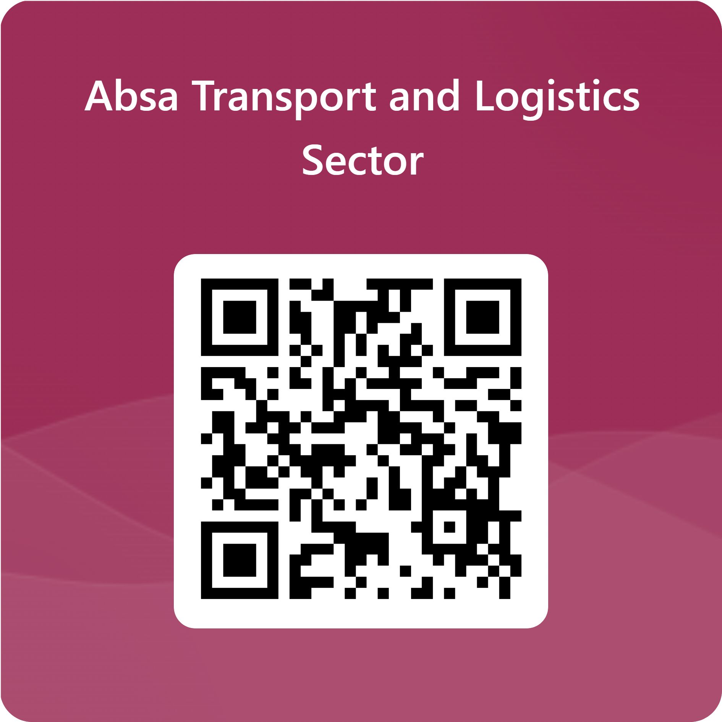
Connect with Absa Transport and Logistics Sector Team

Slide 35
Disclaimer
Absa is an Authorised Financial Services Provider FSP523 Registered Credit Provider Reg No NCRCP7
Disclaimer: This commentary is for information purposes only and you must not regard this as a prospectus for any security or financial product or transaction. Absa does not expressly, tacitly or by implication represent, recommend or propose that the securities and/or financial or investment products or services (the “Products”) referred to in this commentary are appropriate and/or suitable for your particular investment objectives or financial situation or needs.
This commentary is not, nor is it intended to be, advice as defined and/or contemplated in Financial Advisory and Intermediary Services Act, 37 of 2002 (“FAIS”), or any other financial, investment, trading, tax, legal, accounting, retirement, actuarial or other professional advice or service whatsoever (“advice”). All the risks and significant issues related to or associated with the Products are not disclosed and therefore, prior to investing or transacting, you should fully understand the Products and any risks and significant issues related to or associated with them.
This commentary is neither an offer to sell nor a solicitation of an offer to buy any of the Products, which shall always be subject to Absa’s internal approvals and the execution of all requisite documentation between you and Absa. You have to obtain your own advice prior to making any decision or taking any action based hereon and neither Absa, nor any affiliate, nor any of their respective officers, directors, partners, or employees (in whose favor this constitutes a stipulation on behalf of another) accepts any liability whatsoever for any direct, indirect or consequential damages or loss arising from any use of or reliance on this publication or its contents, and irrespective of whether or not you have obtained independent advice.
E-mail disclaimer and company information: absa.co.za/disclaimer.

