Slide 1






Slide 2
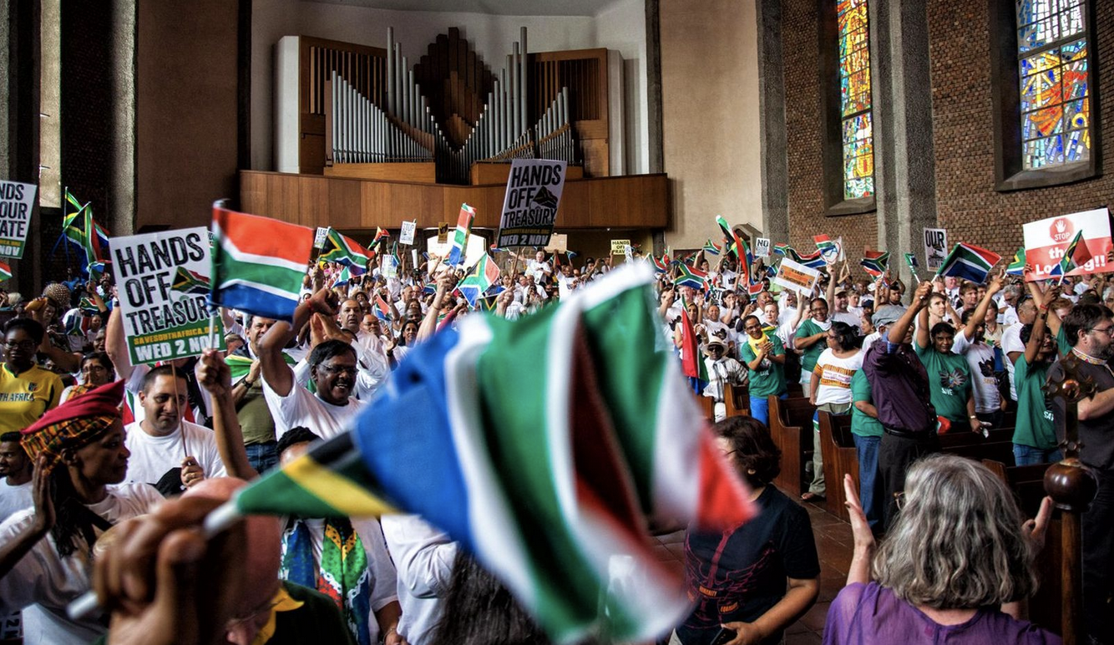
SHIFTING GEARS AND FLAGS
The GNU, the ANC, and the emergence of a new political reality in SA
Presentation by Justice Malala

Slide 3
WE NEED TO TALK

Slide 4
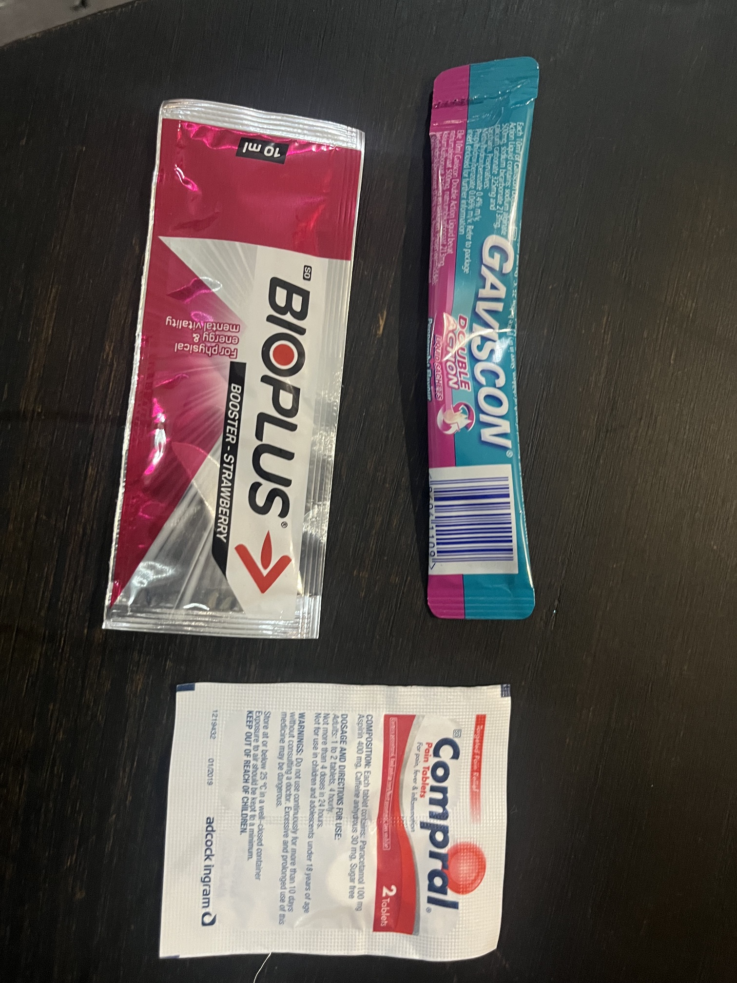

Slide 5
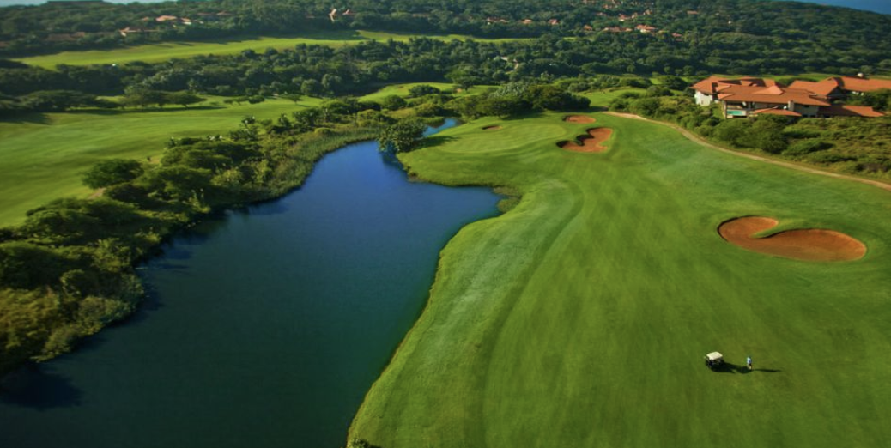


Slide 6


Slide 7
OH OH…HERE COMES JUSTICE

Slide 8
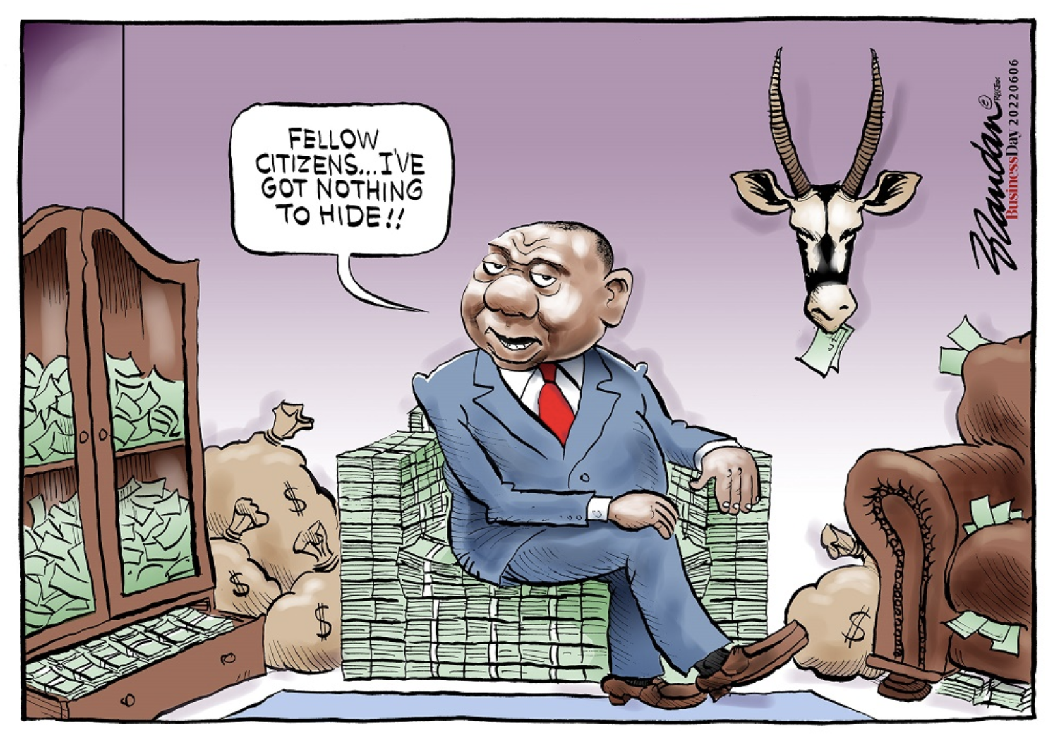

Slide 9
AS IF THAT’S NOT ENOUGH PROBLEMS…

Slide 10
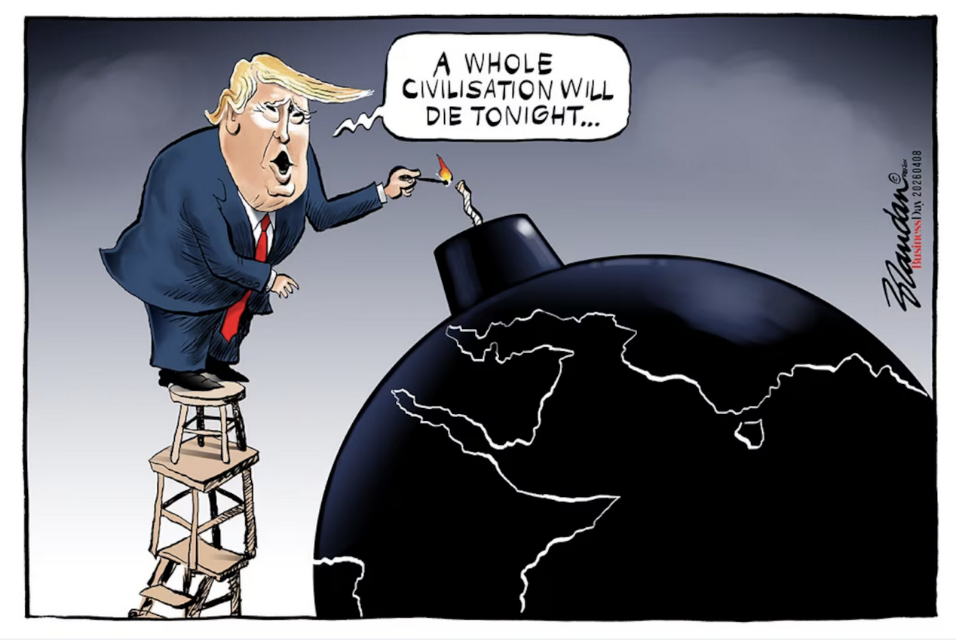

Slide 11
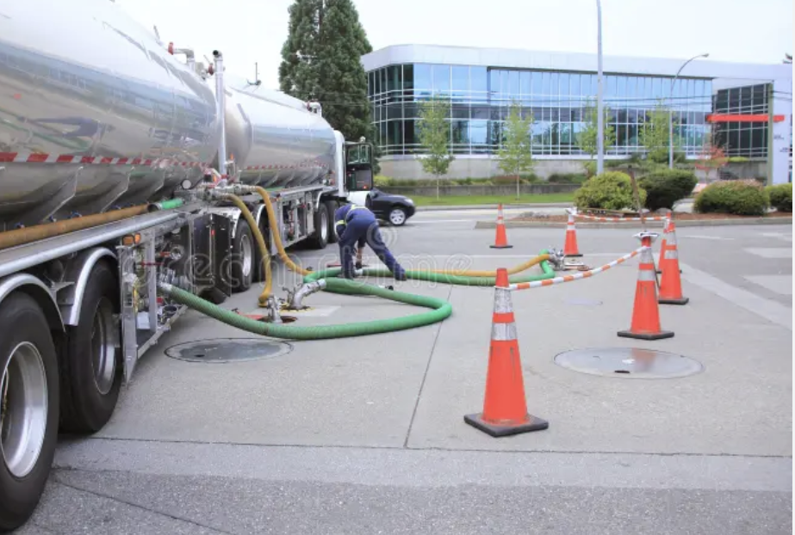

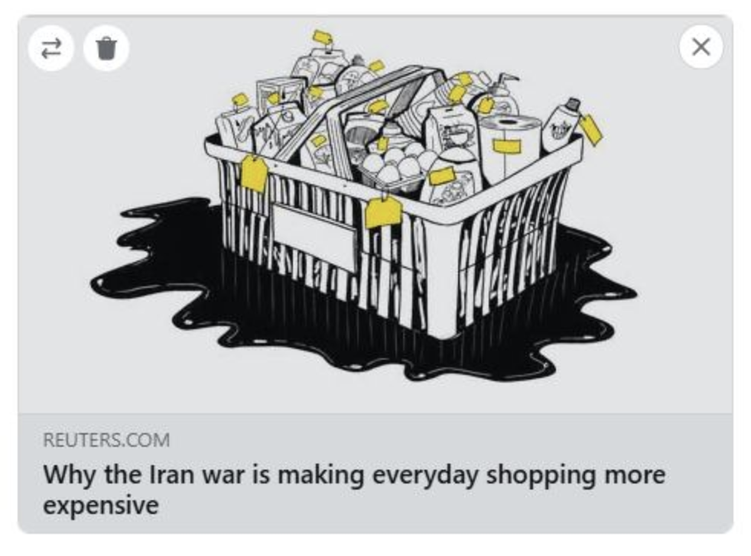

Slide 12
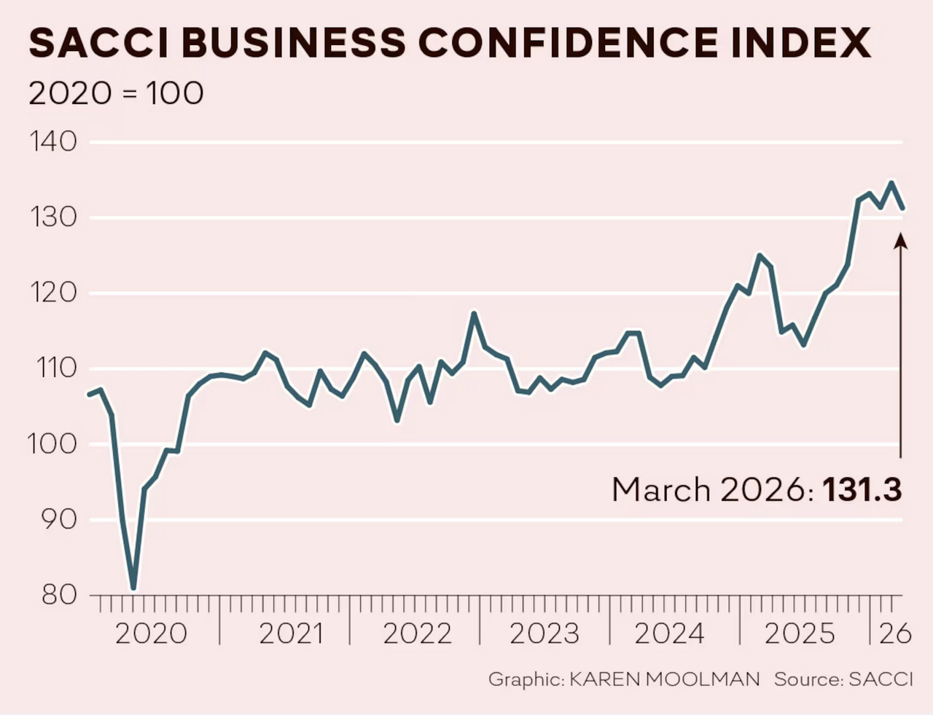

Slide 13
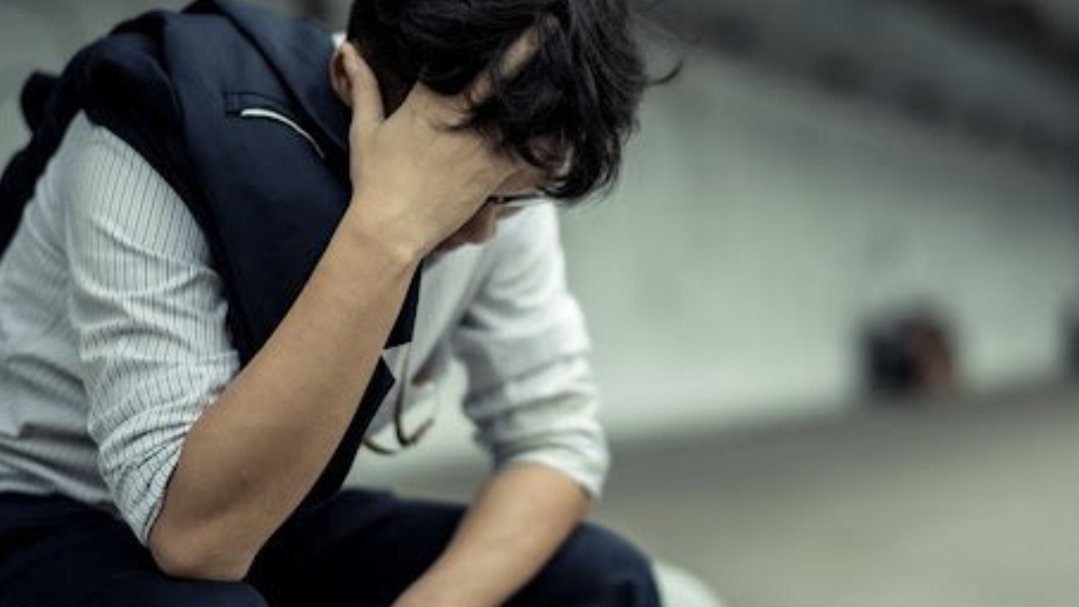

Slide 14
AND SO, SUNTER’S FLAGS

Slide 15
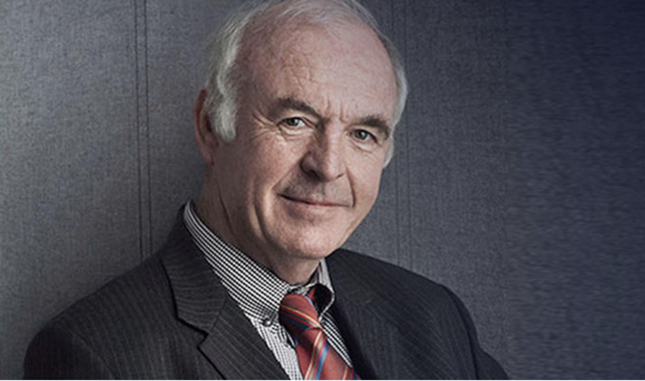

Slide 16
Which flag is going up, which down?
The Red Flag: Tensions involving Russia, China, and North Korea, particularly regarding the war in Ukraine and the risk of a "Third World War". Now, Iran.
The Green Flag: Climate change and the global response to environmental sustainability.
The Grey Flag: Ageing populations in the West and China, which impact long-term economic growth.
The Religious Flag: Potential conflicts and competition between major world religions.
The AI Flag: The impact of Artificial Intelligence on jobs and security.

Slide 17
IF THE FLAGS ARE DOWN, THEN…

Slide 19
IF THE FLAGS ARE UP, THEN…

Slide 20
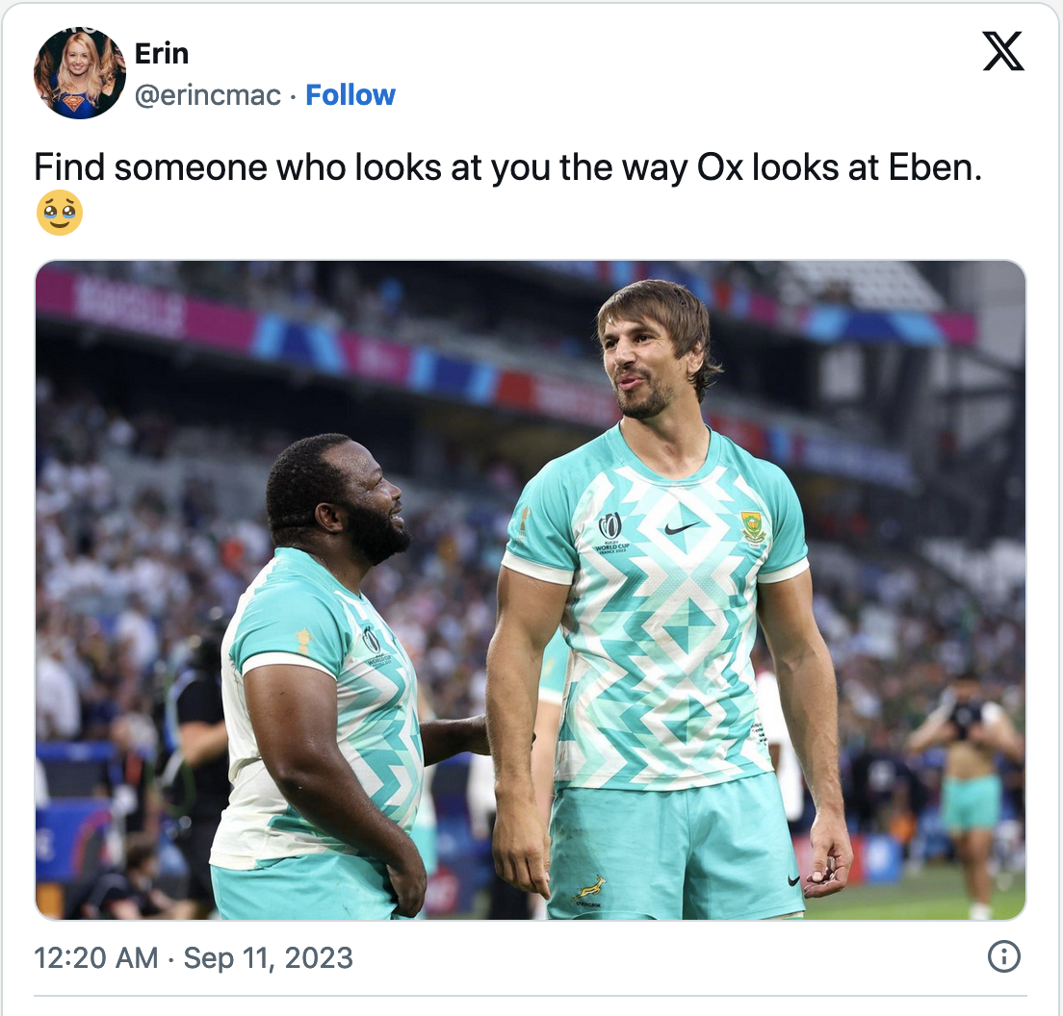

Slide 21

HERE’S YOUR EBEN….

Slide 22
MOST IMPORTANT SA FLAG: INSTITUTIONS

Slide 23
1. The Judiciary and Court System
2. Independent Oversight Institutions ("Watchdogs")
  Auditor-General (AG):
  Public Protector / Ombudsman:
  South African Human Rights Commission (SAHRC):
3. Electoral and Regulatory Bodies
Independent Electoral Commission (IEC):
Independent Communications Authority (ICASA):
4. Law Enforcement and Integrity Bodies
  National Prosecuting Authority (NPA):
  Independent Police Investigative Directorate (IPID):
5. Specialized Commissions
Commission for Gender Equality (CGE):
Commission for the Promotion and Protection of the Rights of Cultural, Religious and Linguistic Communities (CRL Rights Commission):
Commission for Conciliation, Mediation and Arbitration (CCMA):

Slide 24
Key Characteristics of Resilient Institutions
Independence
Impartiality
Accountability

Slide 25
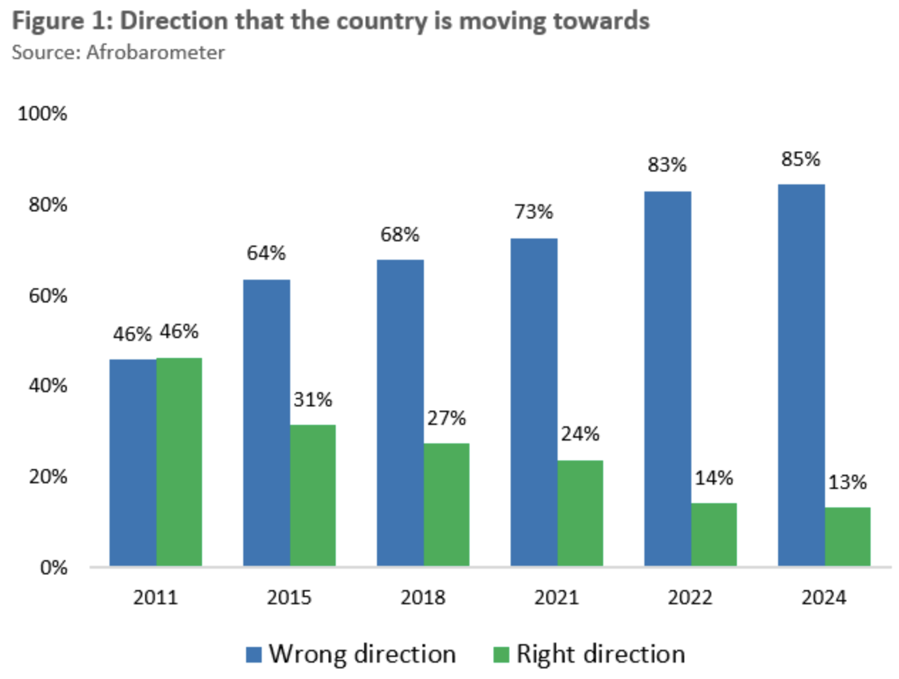

Slide 26
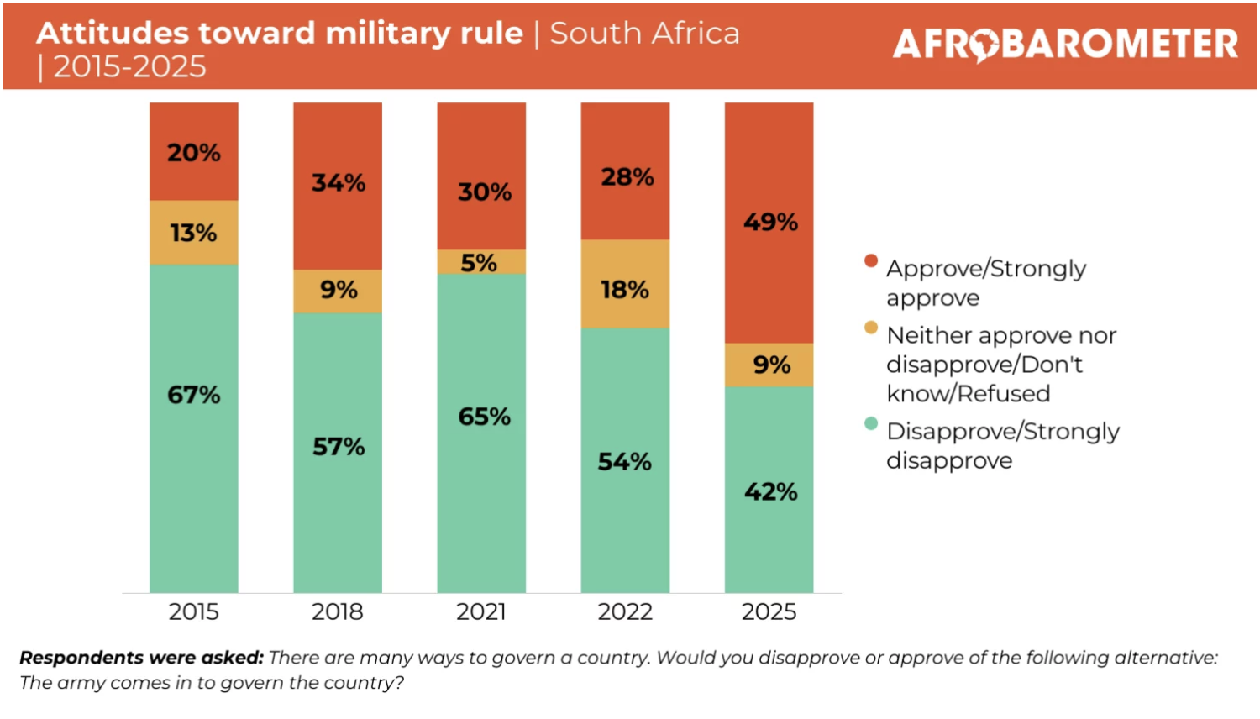

Slide 27

“There’s no such thing as bad weather, ONLY BAD CLOTHES.” – Swedish Idiom

Slide 28
FLAG ONE: GNU SURVIVAL

Slide 29
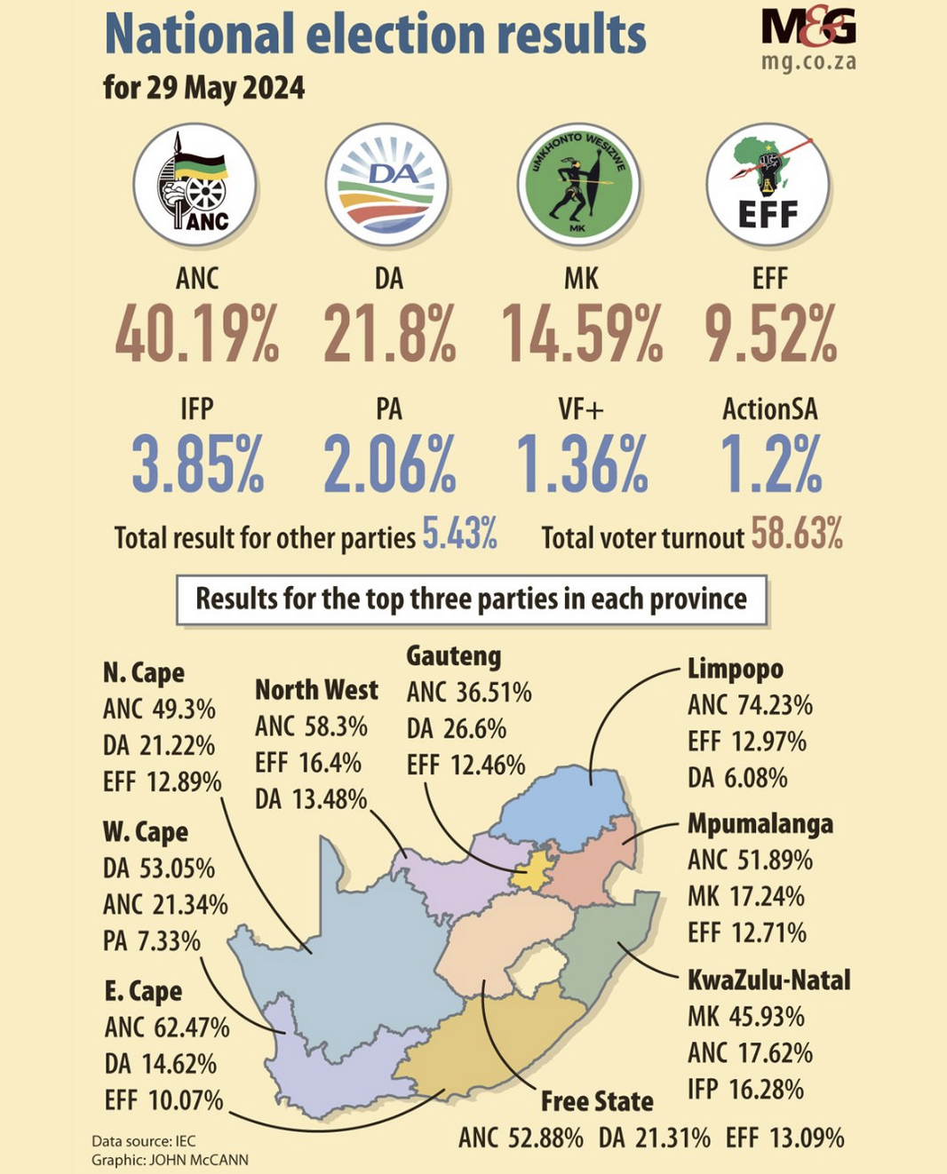
A HISTORIC ELECTION – AND RESULT

Slide 30
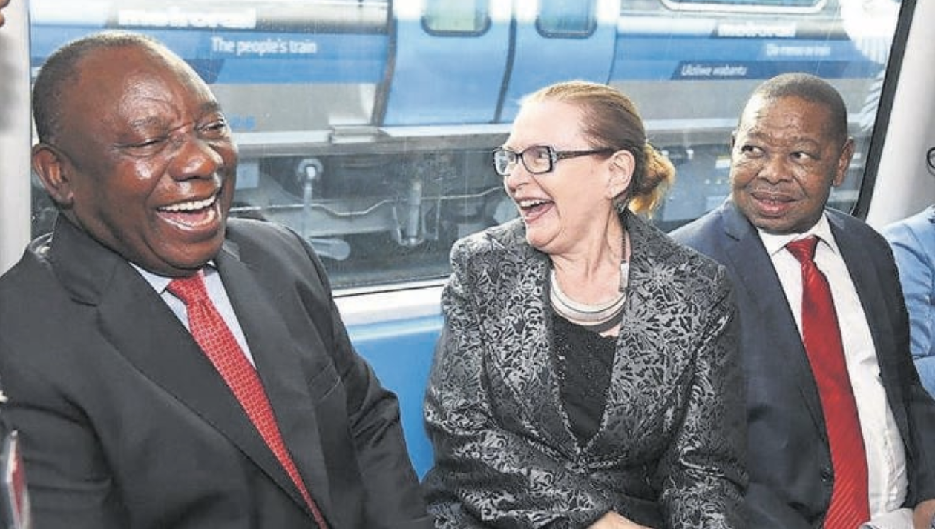
TOGETHER AT LAST!

Slide 31
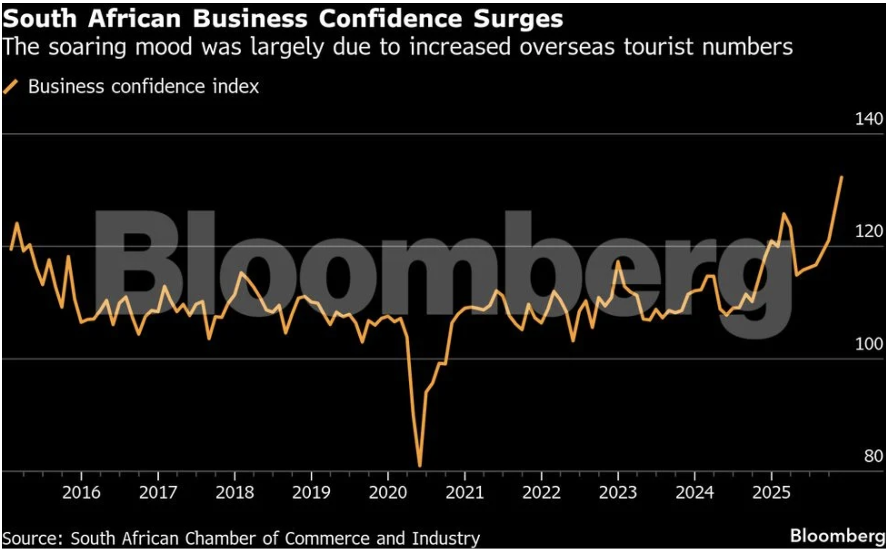

Slide 32
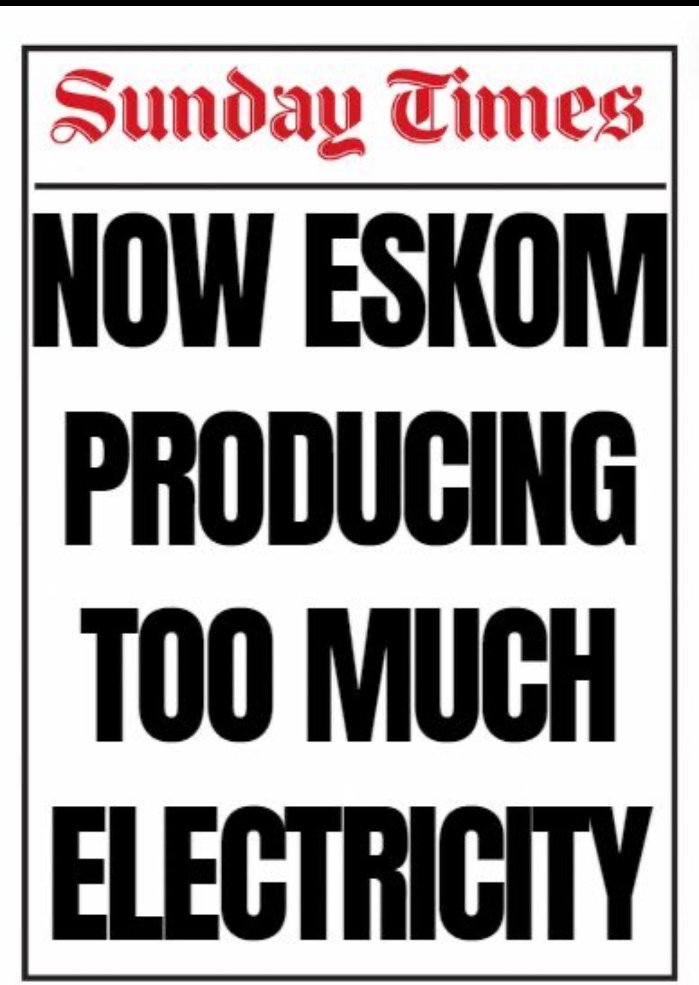

Slide 33
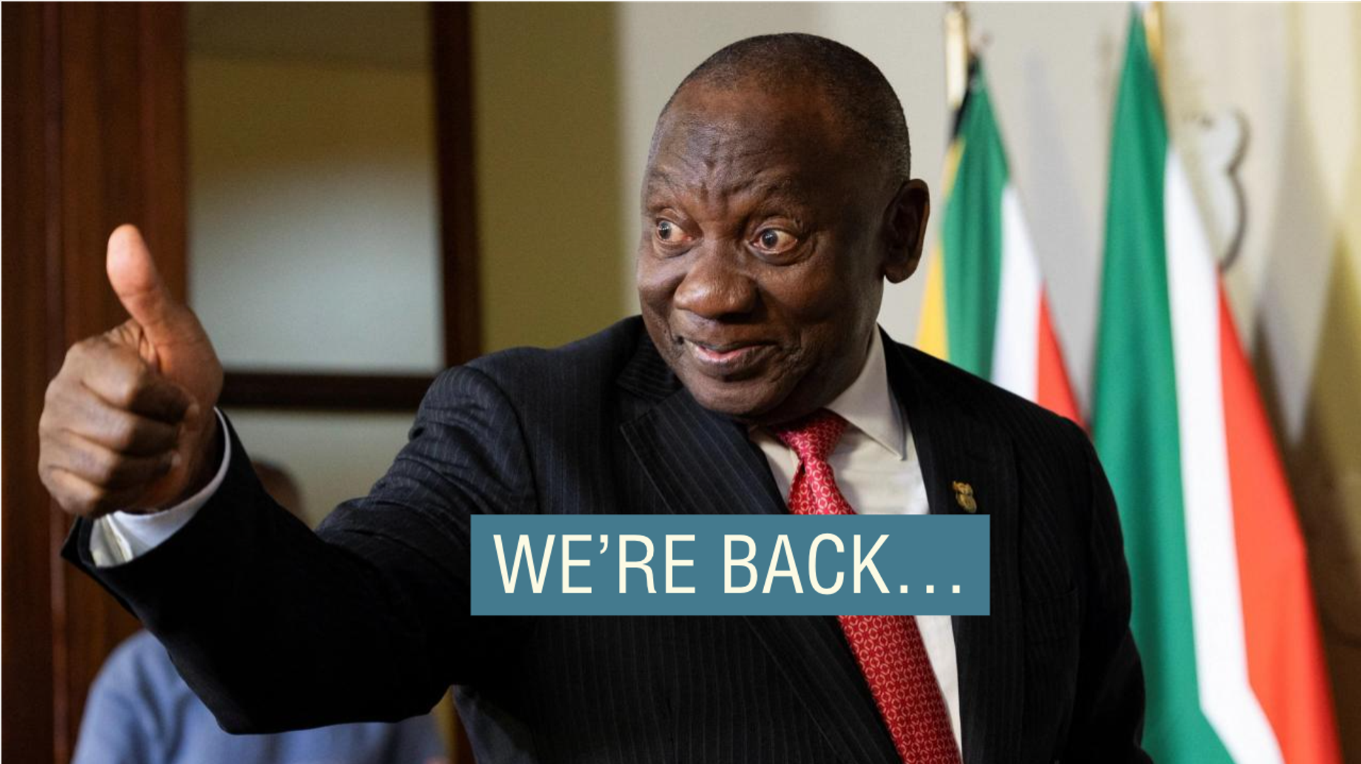

Slide 34
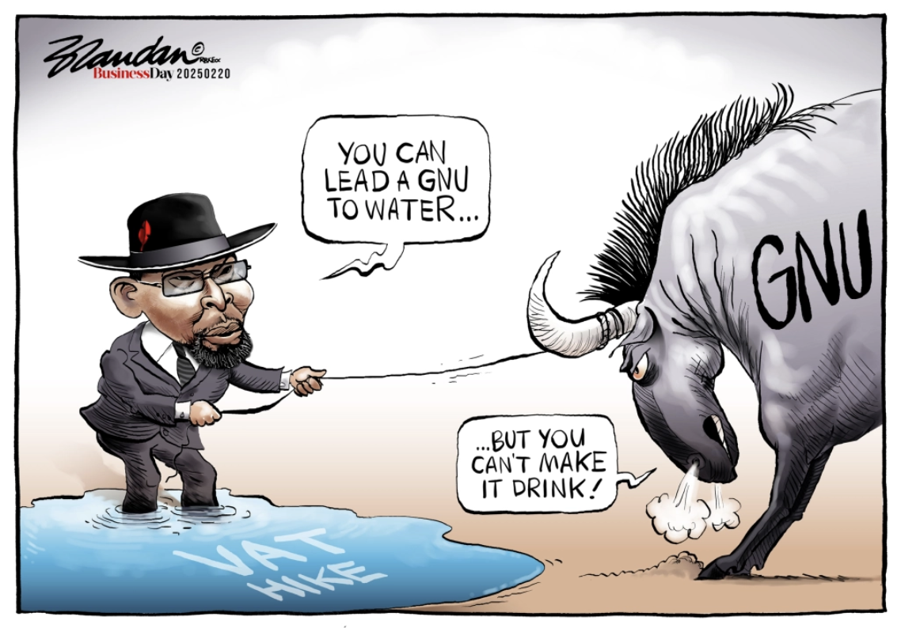

Slide 35
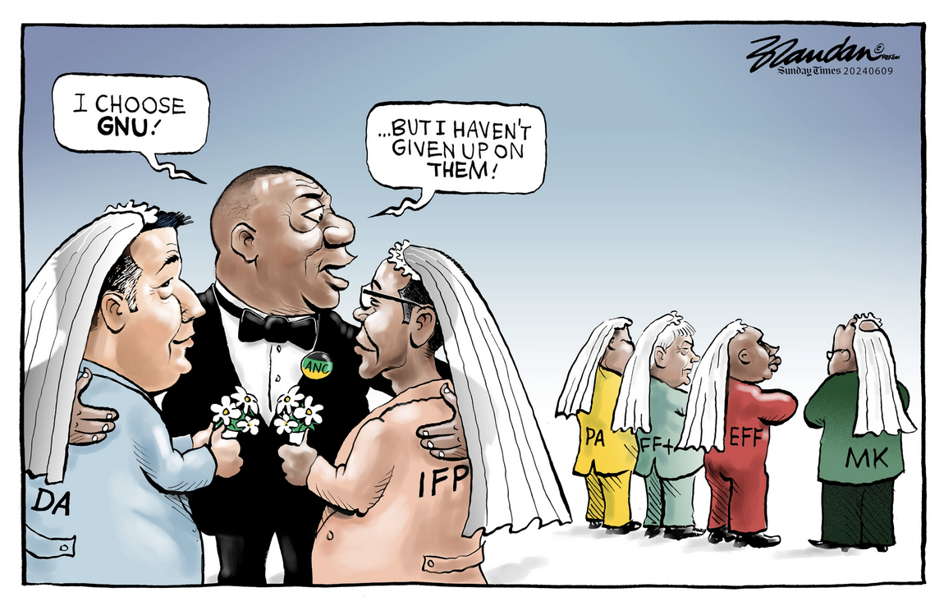

Slide 36
FLAG TWO: THE TRUMP EFFECT

Slide 37
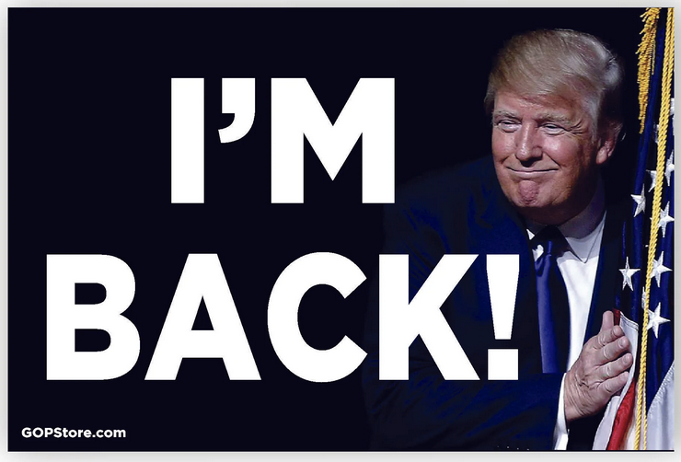

Slide 38
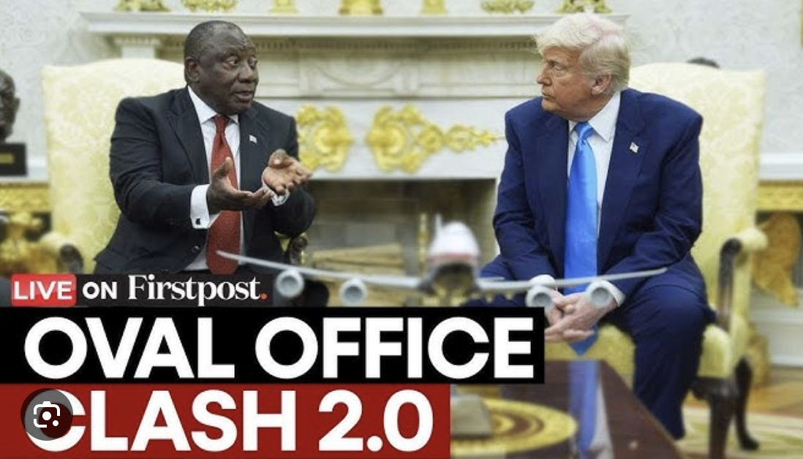
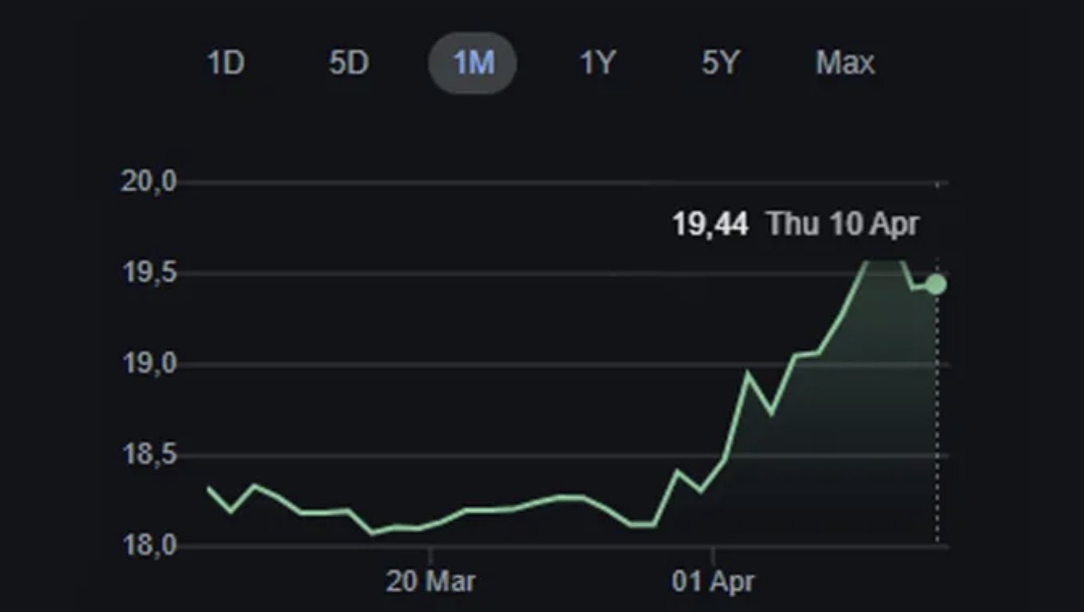
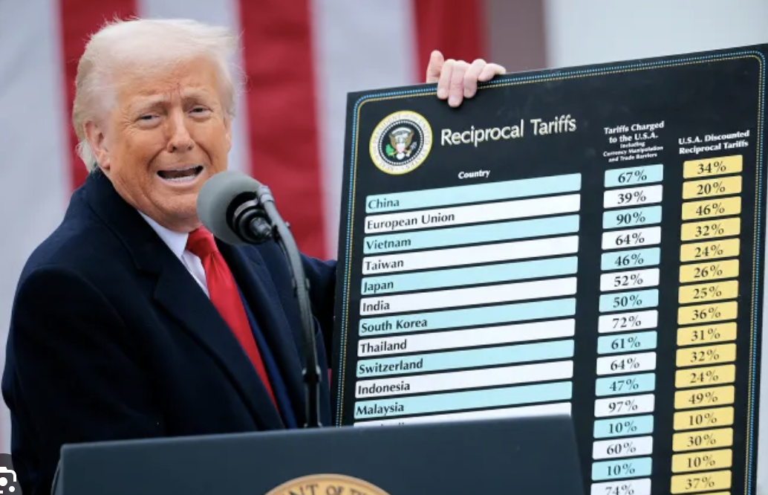

Slide 39
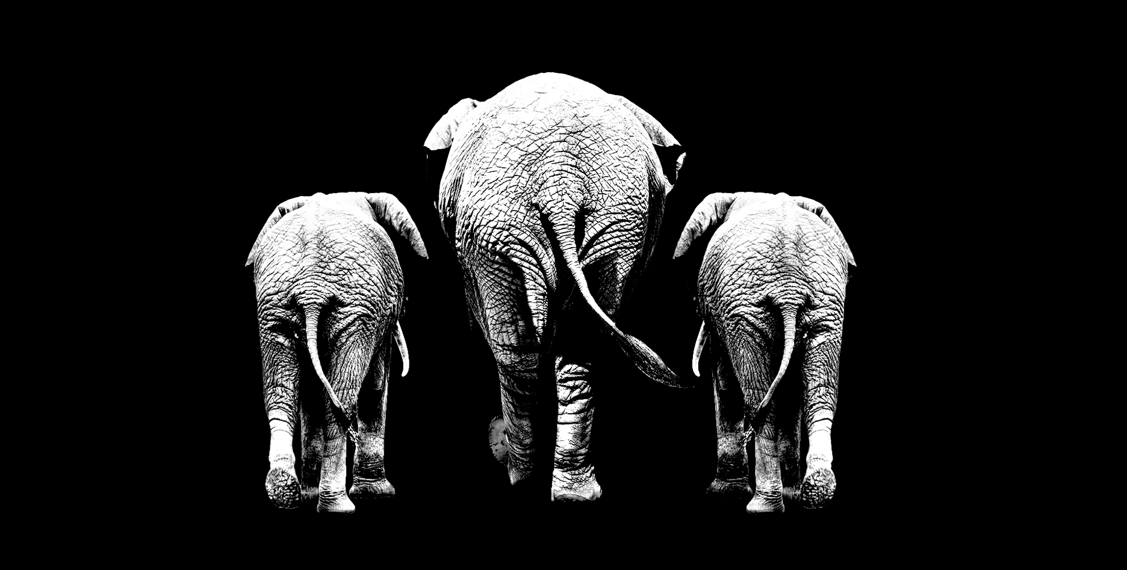
A TRIFECTA – AND MORE
OVAL OFFICE
*
SENATE
*
HOUSE OF REPRESENTATIVES
*
SUPREME COURT
*
REPUBLICAN PARTY IN MAGA IMAGE

Slide 40
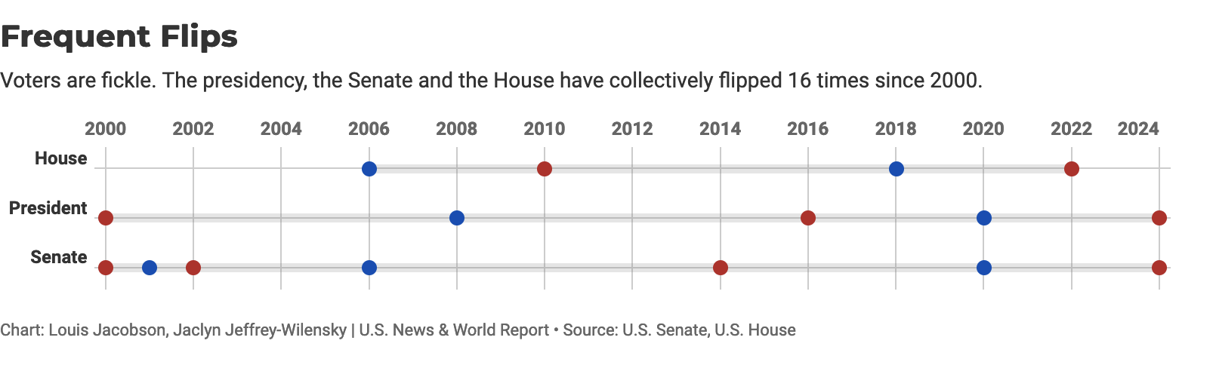
A LEADER, AND A PARTY, IN A HURRY

Slide 41
“To me, the most beautiful word in the dictionary is tariff, and it’s my favorite word.”
DONALD J. TRUMP, OCTOBER 2024

Slide 42
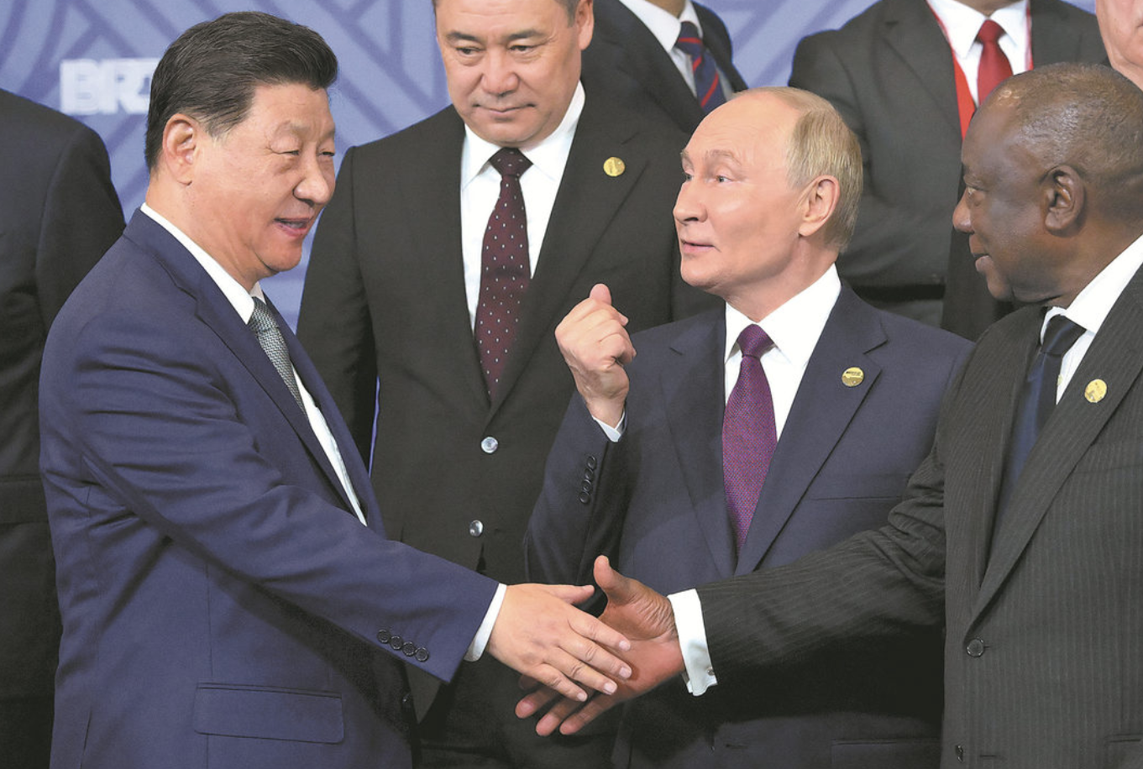
SA SUPPORT FOR RUSSIA, CHINA, PALESTINE, IRAN CHAFES TRUMP ADMIN
“We continue to see Russia as a valued ally, as a valued friend, who supported us right from the beginning: from the days of our struggle against apartheid, right through to now.” –Pres. Ramaphosa, 22/10/2024
“South Africa will remain a trustworthy and reliable friend of China.” – Pres. Ramaphosa, 02/09/ 2024
“We will always be together.” – Pres. Ramaphosa tells Palestine, 24/10/ 2024

Slide 43
NO SA MOVEMENT ON US “STICKING POINTS”
Ties to BRICS
Stance on Russia and Ukraine
ICJ case regarding Israel
Land reform
Black Economic Empowerment (BEE)

Slide 44
RAMAPHOSA ON TRUMP (NYT, 05 March 2026)
“I just thought that he is so uninformed, truly uninformed…. I realized that he is looking at South Africa through a completely, sort of, foggy lens, without realizing the real, real harm that apartheid did. In my view, he was just dismissive.”
“I do think the Afrikaner policy is racist…. It is that racist sort of demeanor that we want to be able to whittle down so that he can see the truth of the situation.”

Slide 45
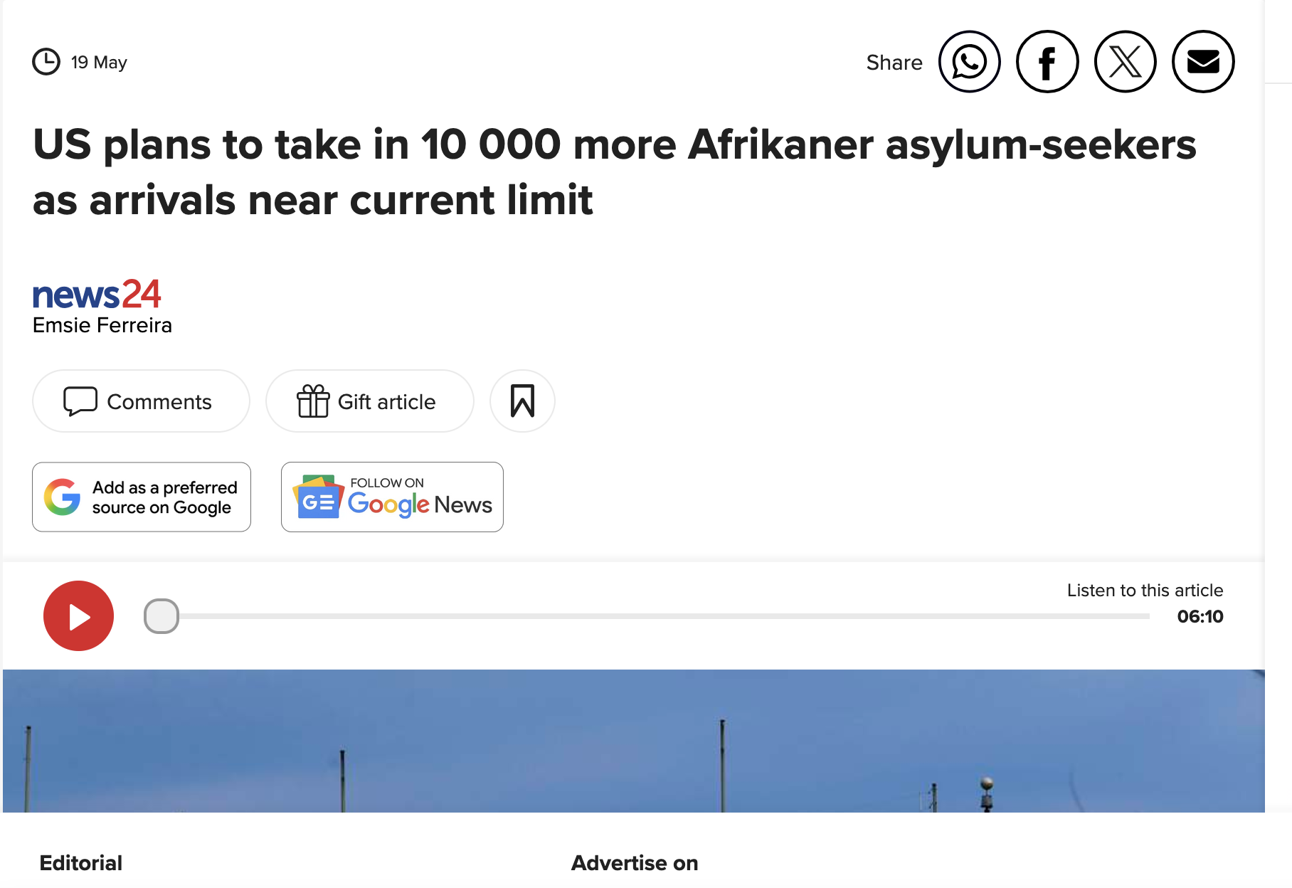

Slide 46
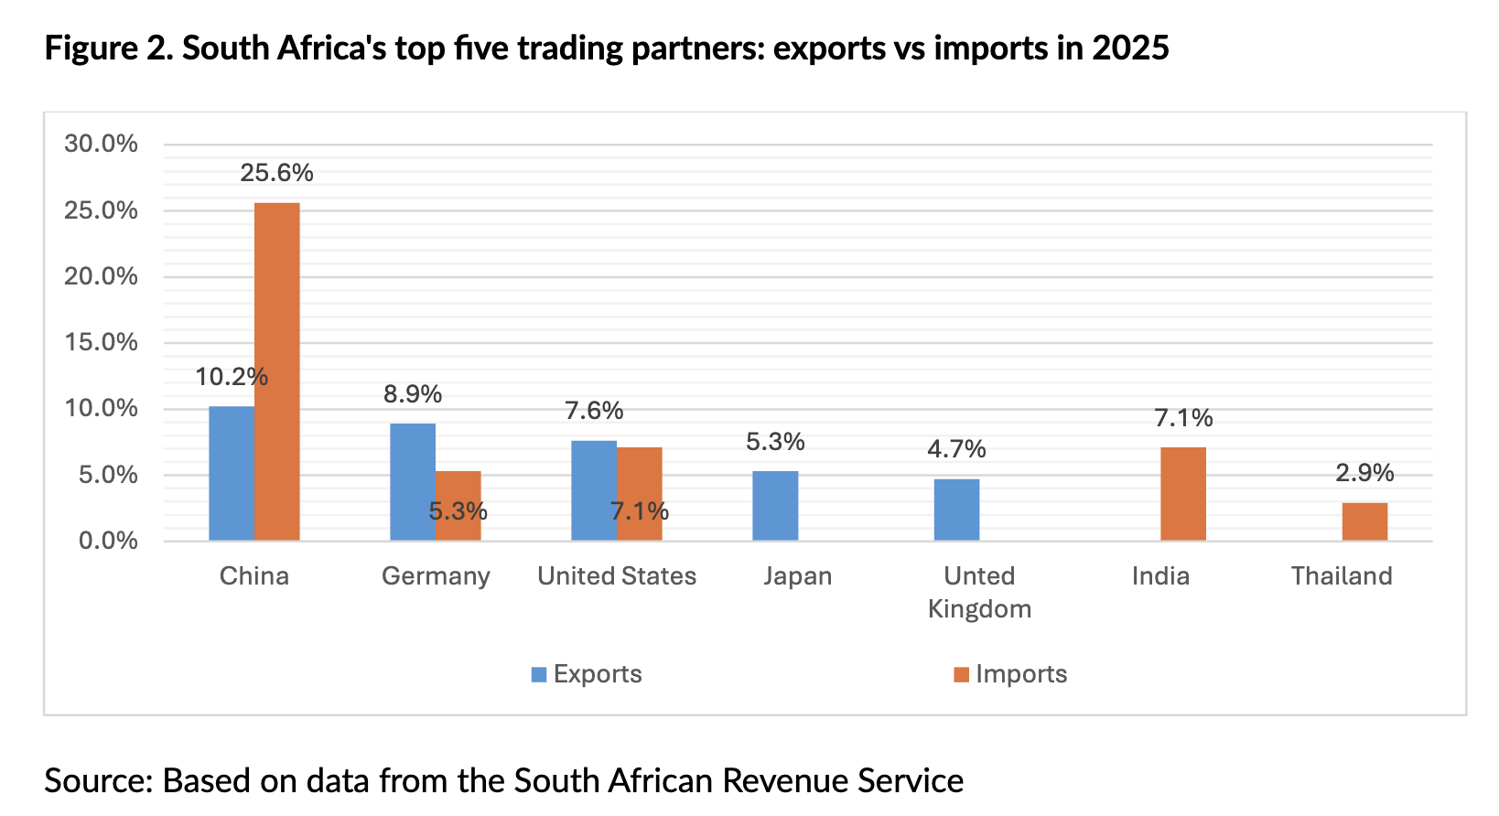

Slide 47
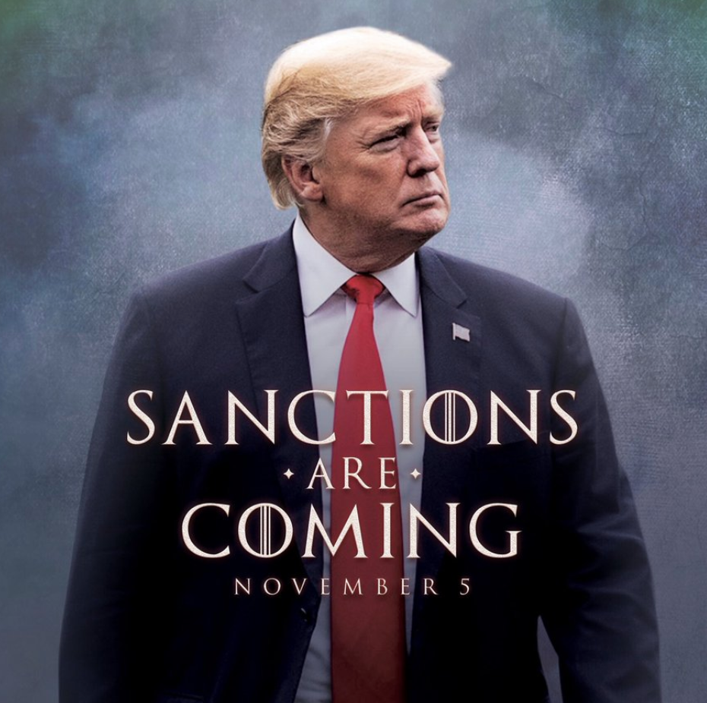
IT MAY GET WORSE

Slide 48
IT MAY GET WORSE
Columnist Jonny Steinberg says Trump could prohibit US institutions from buying South Africa’s sovereign debt: “He does not need new legislation to do this. He could do unthinkable damage to South Africa simply by signing his name.”
On the same point, Sakeliga’s executive director, Russell Lamberti, said: “There is a pressing possibility the Trump admin could place financial flows from US institutions into South African bonds under review.”

Slide 49
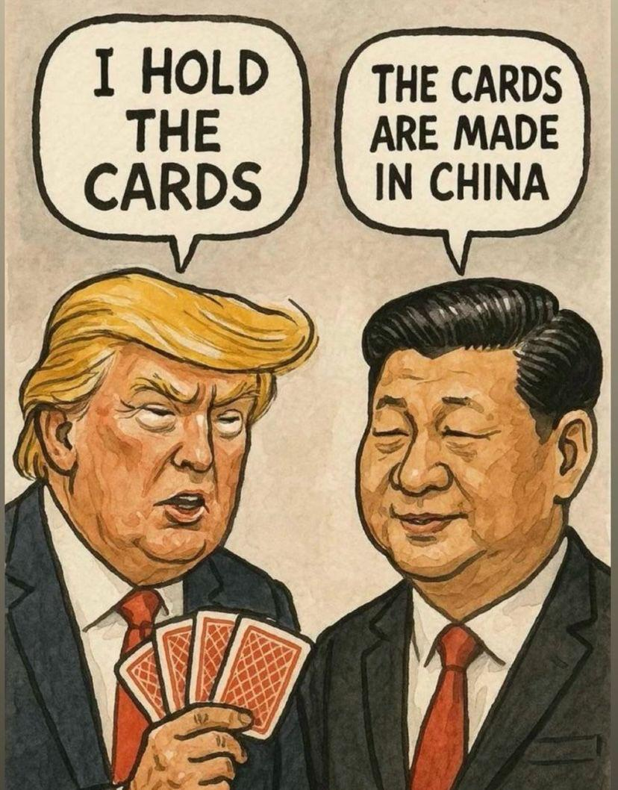
ON AND ON AND ON WHILE THE ELEPHANTS FIGHT…

Slide 50
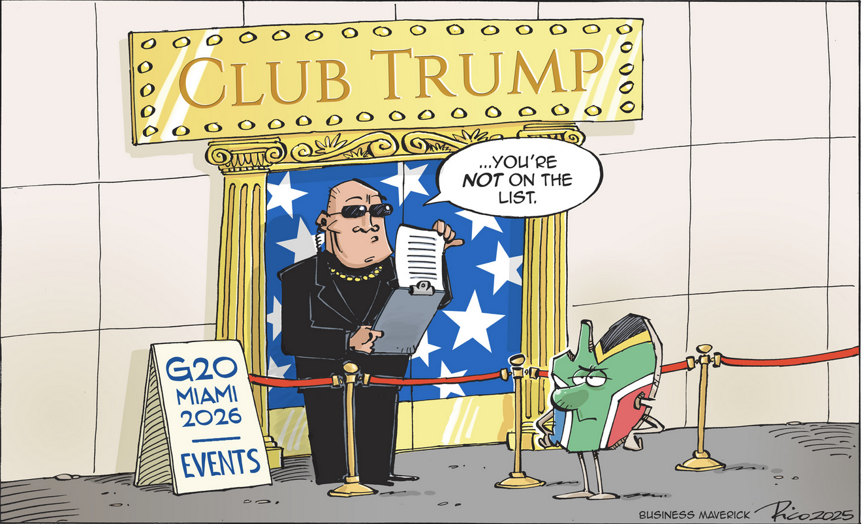

Slide 51
SILVER LININGS
April 6 and May 6 High-Level Meetings [Bozell, deputy ministers]
“South Africa is the United States’ dominant supplier of platinum group metals, chromium, manganese, and military-grade vanadium — minerals that underpin US defence systems, semiconductor manufacturing, automotive production, and any serious reindustrialisation agenda. They have no viable allied alternatives: The next largest producers are foreign entities of concern, primarily Russia and China.” – Centre for Strategic and International Studies
Over 600 American companies still operate in South Africa - pressure

Slide 52
KEY DATE US: 03 NOVEMBER 2026
U.S. House of Representatives: Democrats are currently favoured to regain control. Generic ballot polling shows Democrats leading Republicans by an average of 5.3%.
U.S. Senate: Republicans are favoured to retain their majority due to a highly advantageous map. Republicans are defending 22 seats compared to 13 for Democrats, but 21 of those GOP seats are in states Trump won in 2024.

Slide 53
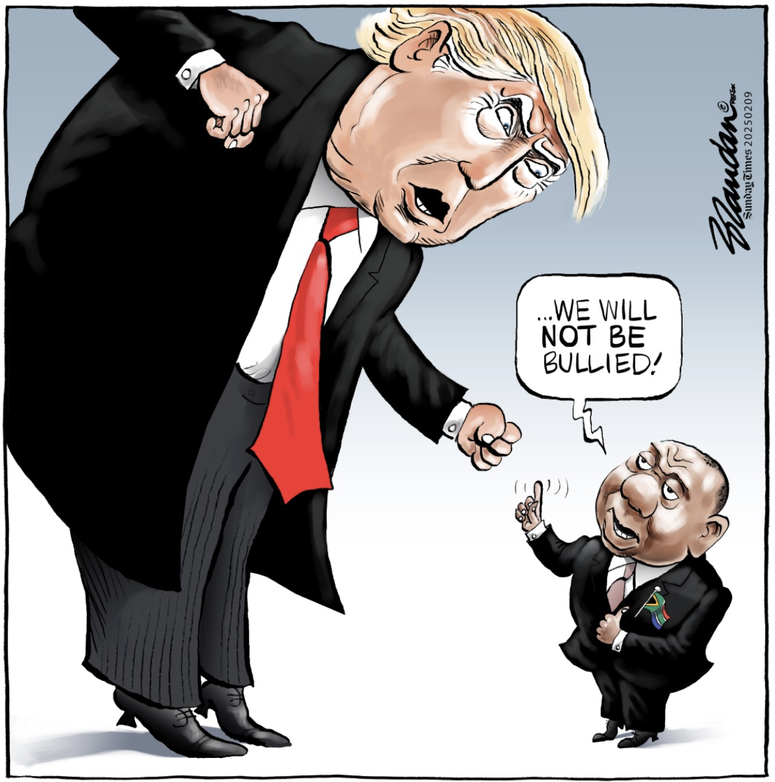

Slide 54
FLAG THREE: “ILLEGAL IMMIGRATION” PROTESTS - SEEDS OF 80s AND JULY 2021

Slide 55

THE TINDER
Mystery leadership, funding, and organisational structures: Similar to 2021, the leadership and authority figures of the protests are AMORPHOUS.
Targeted Vigilantism: Operation Dudula and the “March and March” lead in vigilantism.
Forced Displacement & Fear: Foreign nationals are fleeing their homes, seeking refuge at the Durban Central Police Station and Diakonia.
Economic & Social Scapegoating: Protesters blame illegal immigrants for unemployment, crime, and decay, narratives that fuelled the 2008/2015 violence.
Violent Threats & Deadlines: Similar to previous waves, current protesters have issued ultimatums, demanding undocumented immigrants leave the country by June 30.
Urban Focus & Economic Disruption: Similar to 2021.

Slide 56
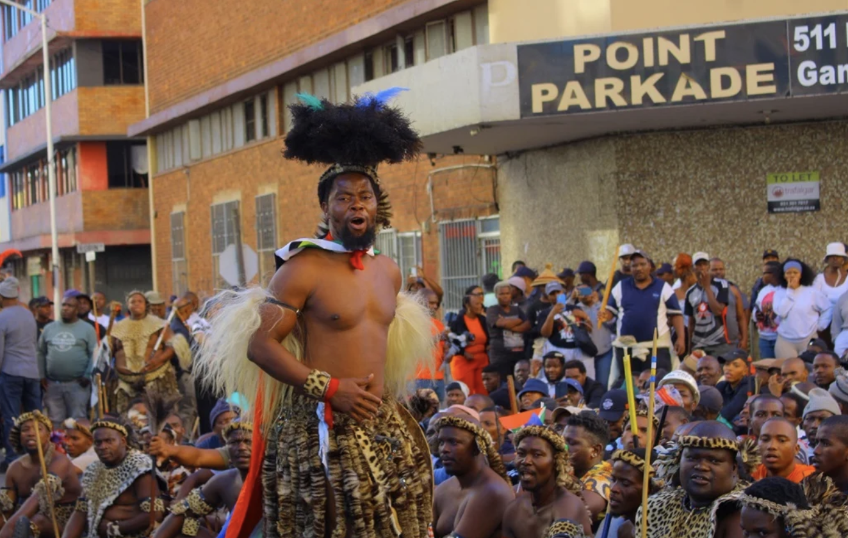
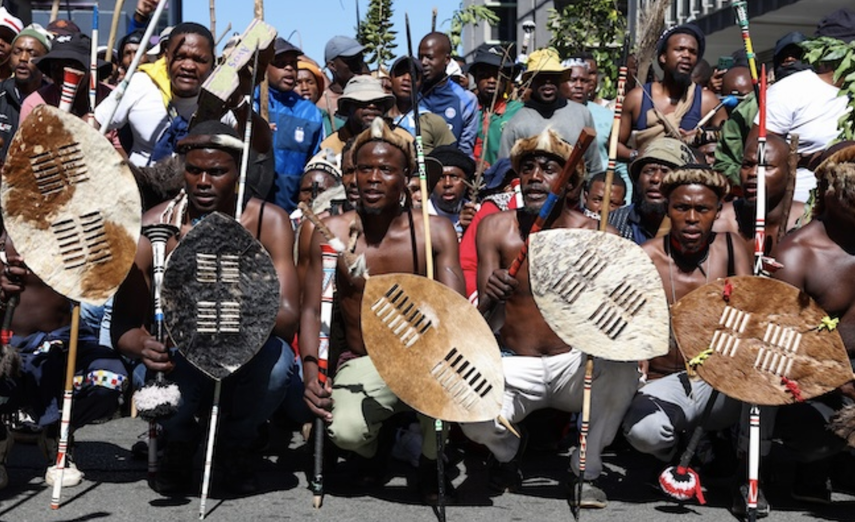
ECHOES OF INKATHA / 1990s MOBILISATION

Slide 57
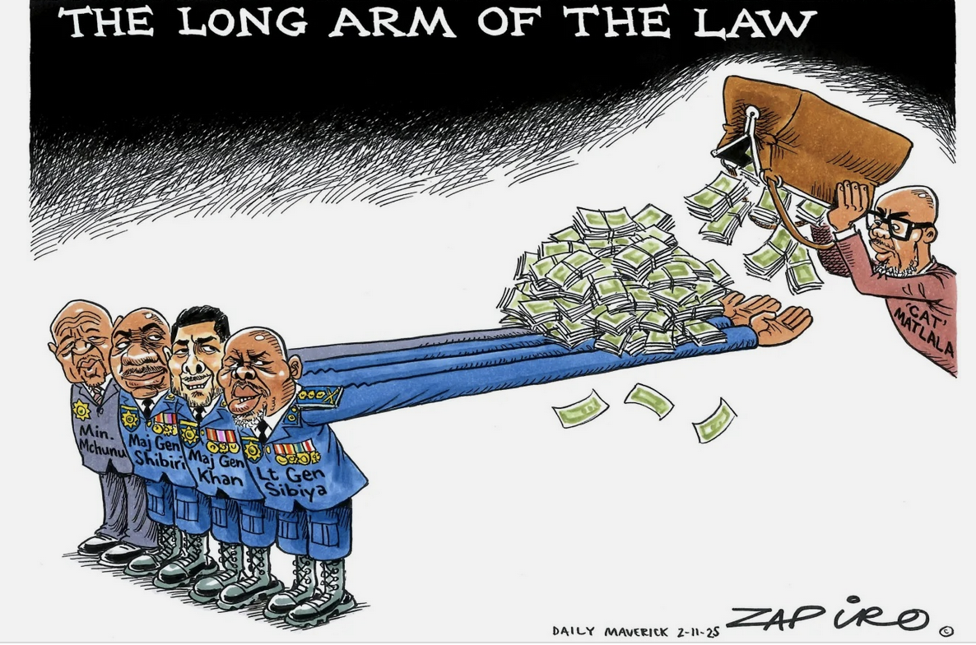

Slide 58
FLAG FOUR: ANC RUCTIONS WEIGH ON GNU

Slide 59
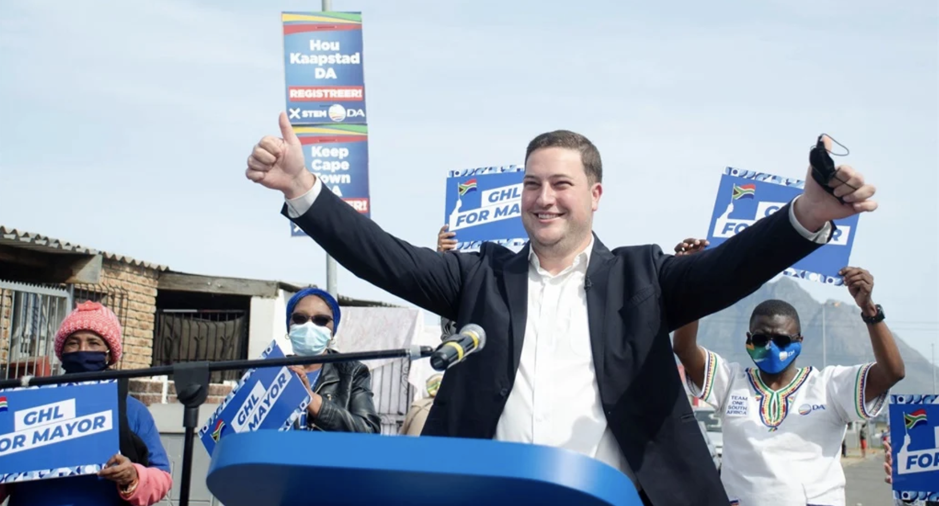
BRAVE NEW LEADERSHIP?

Slide 60
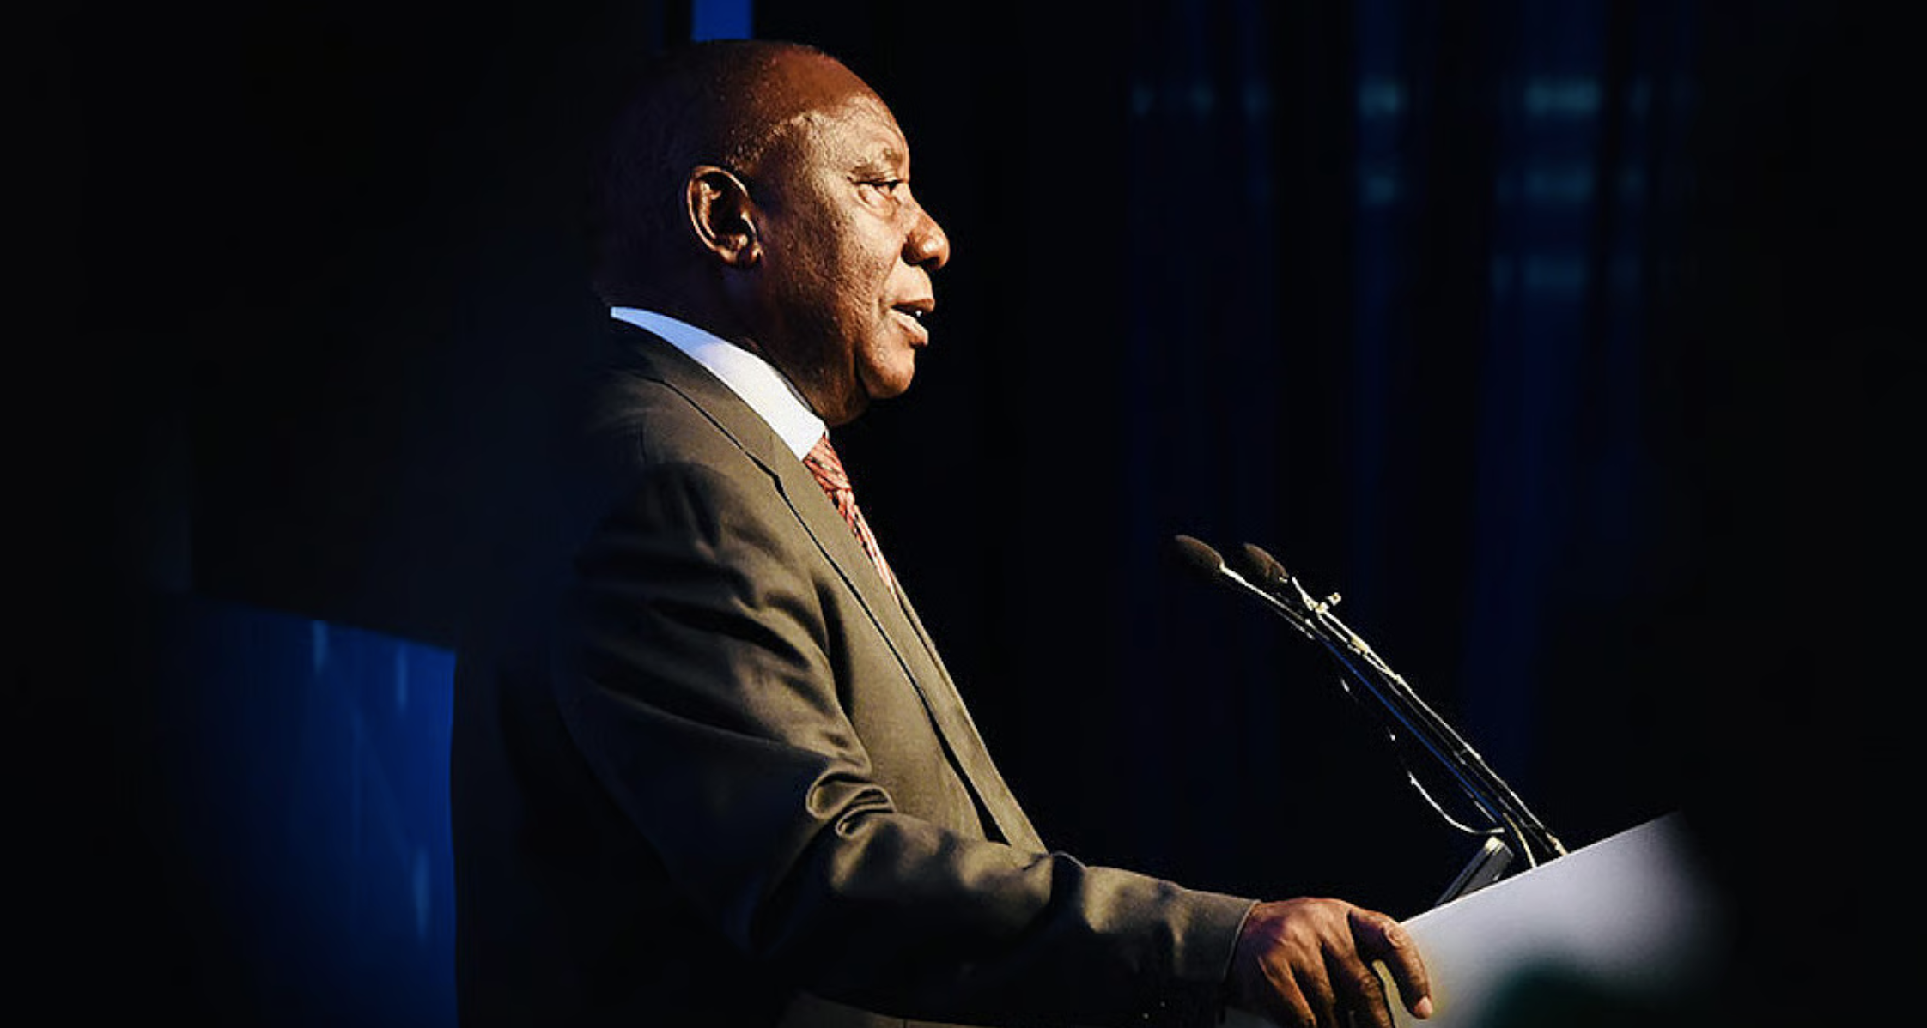
IN THE DEPARTURE LOUNGE? WHEN?

Slide 61
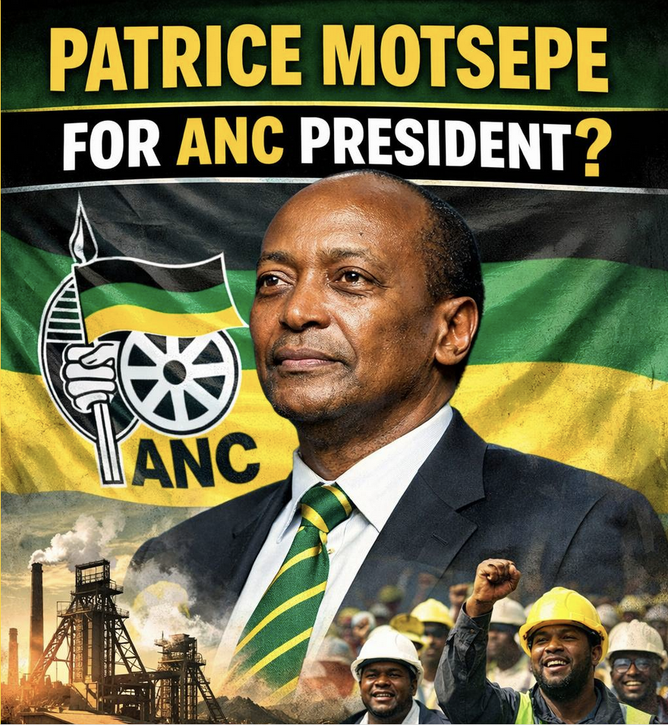
ANC SUCCESSION: INTERESTING TURN

Slide 62
FLAG FIVE: ELECTION 2026 – THE MKP COMETH

Slide 63
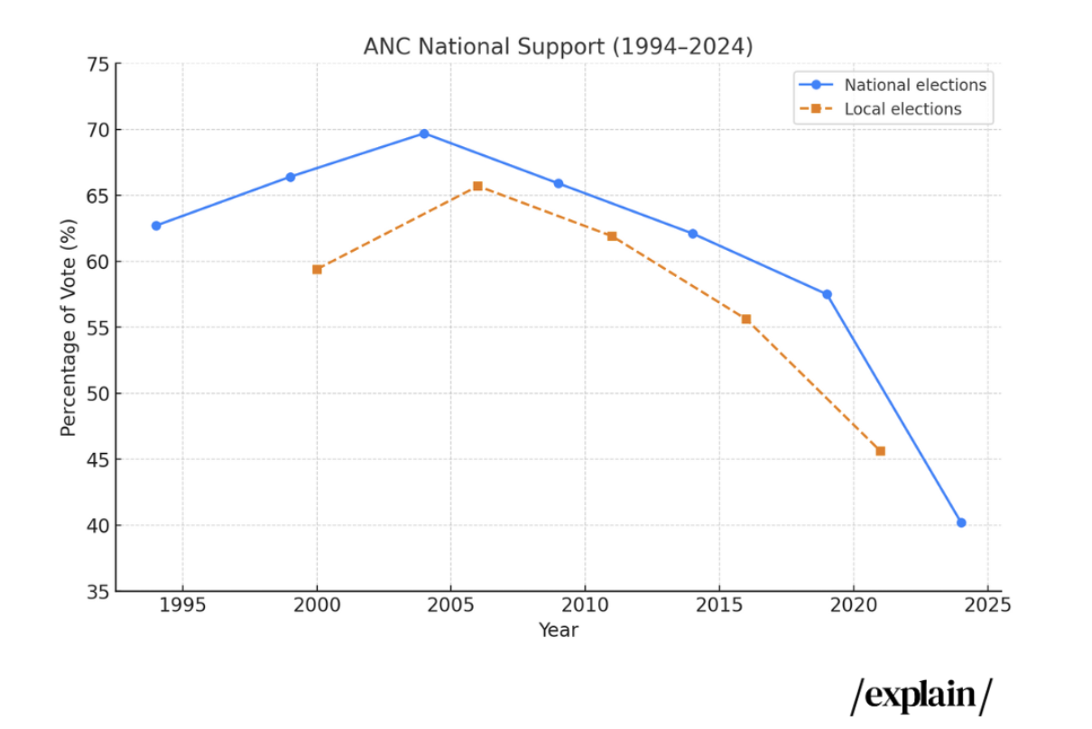
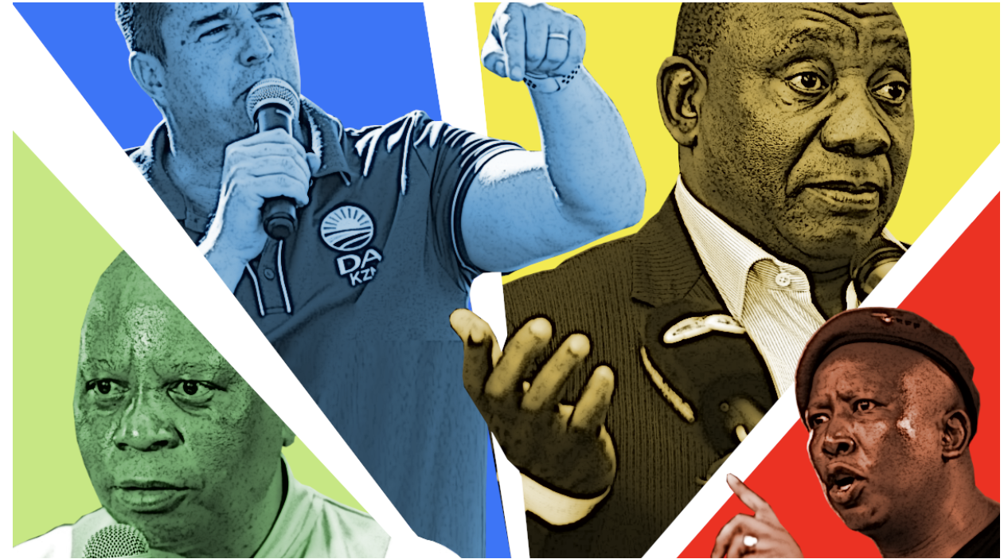
ELECTION 2026: 04 NOVEMBER

Slide 64
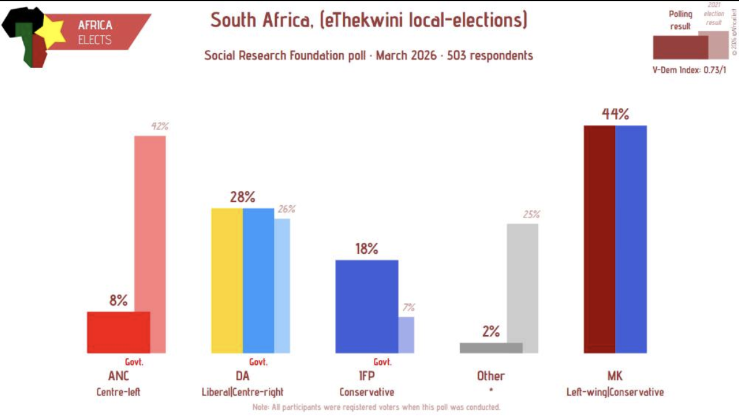

Slide 65
THE DA RISES, TOO…

Slide 66
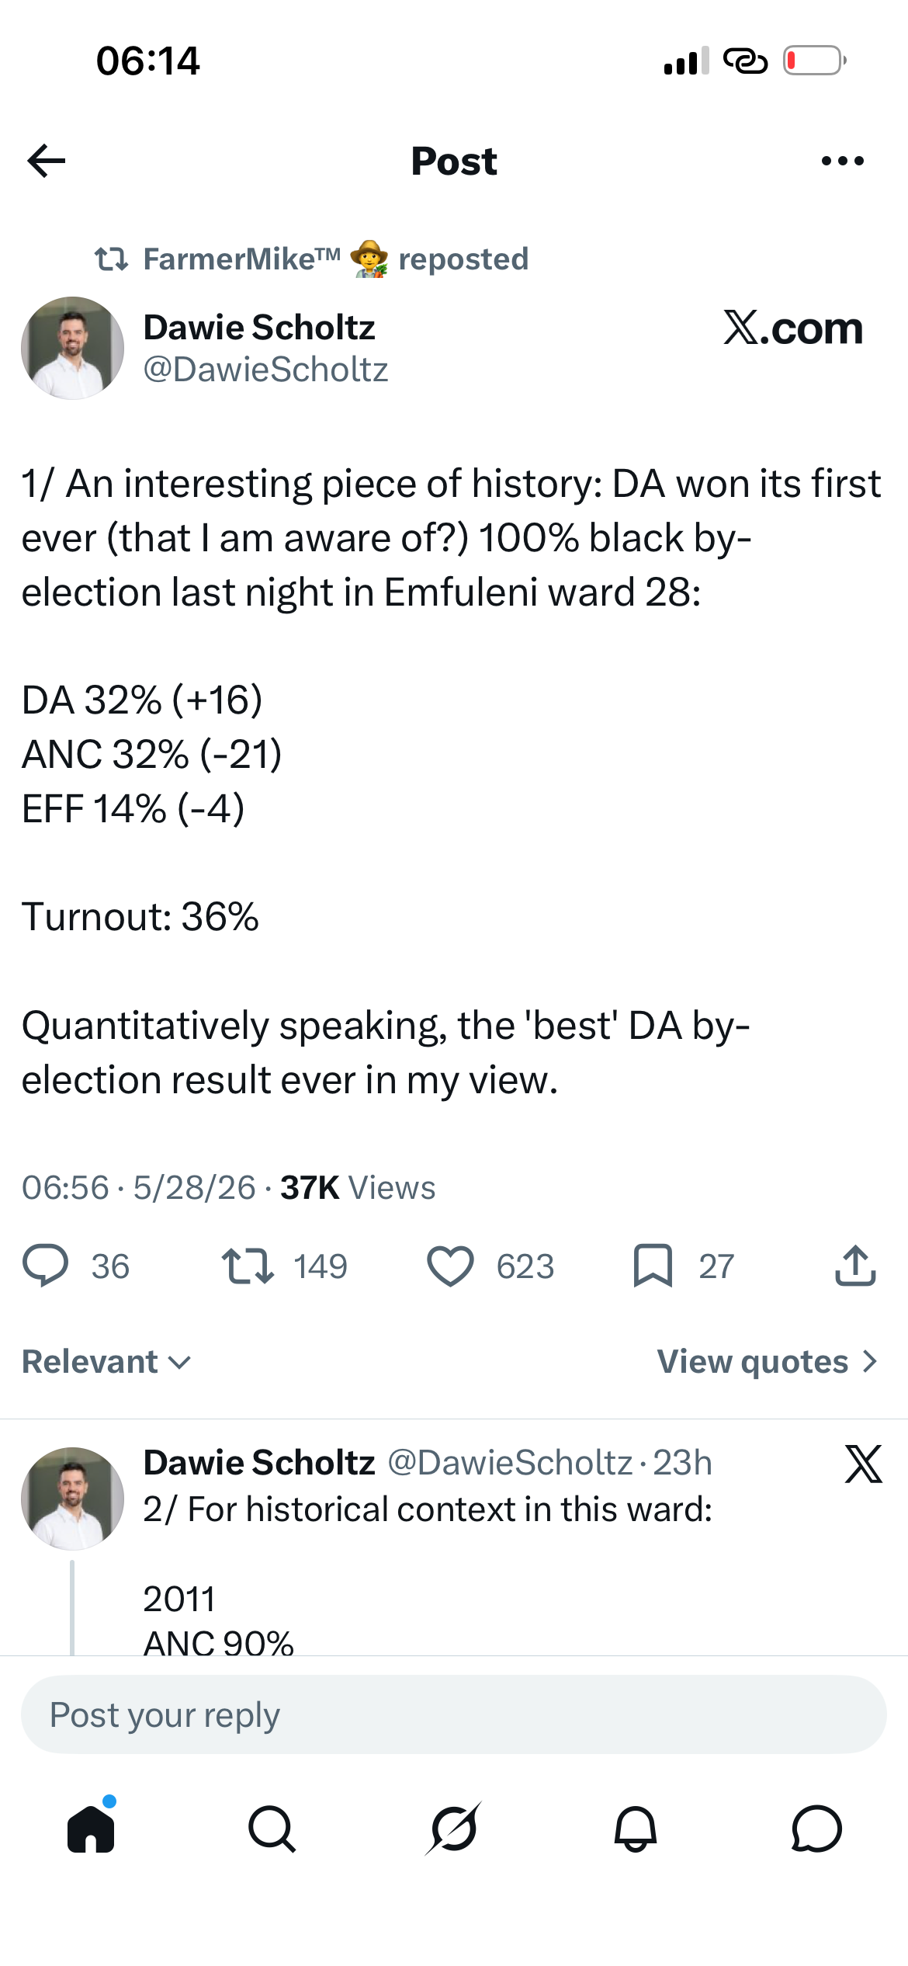
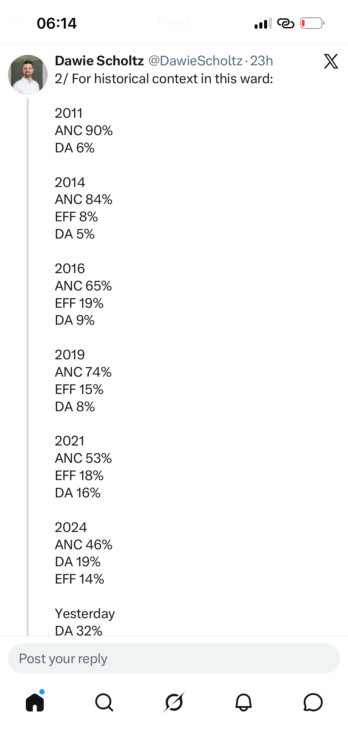
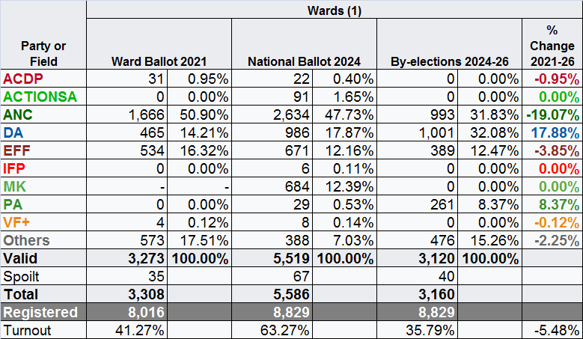

Slide 67
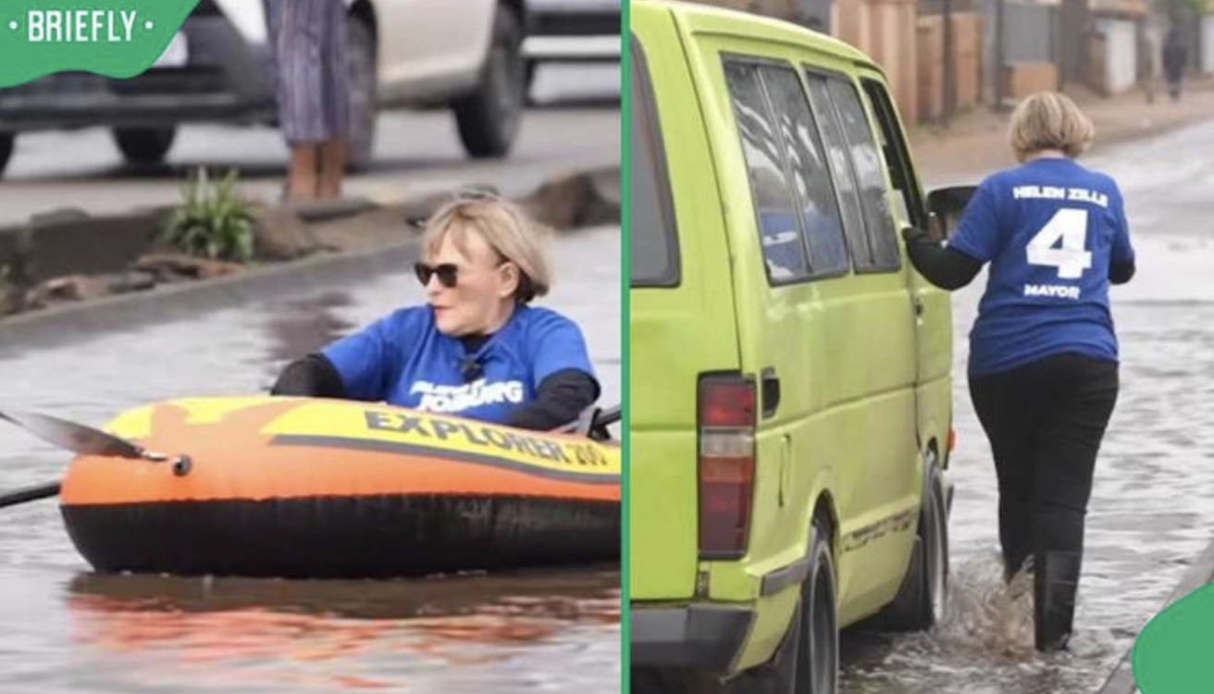
WHICH AUGURS WELL FOR…

Slide 68
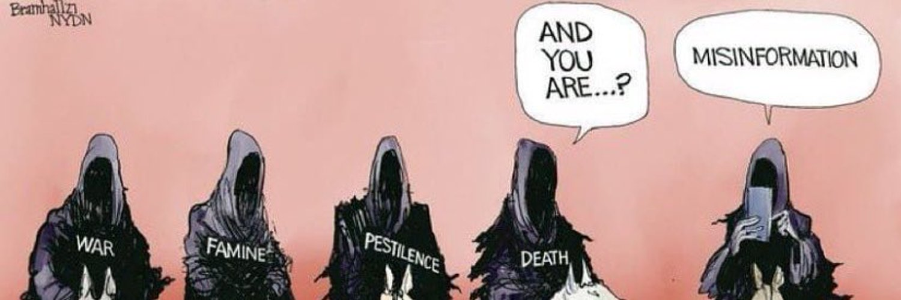
THE GREATEST THREAT TO ELECTION 2026?

Slide 69
IT’S NOISY, BUT NOT ALL BAD

Slide 70
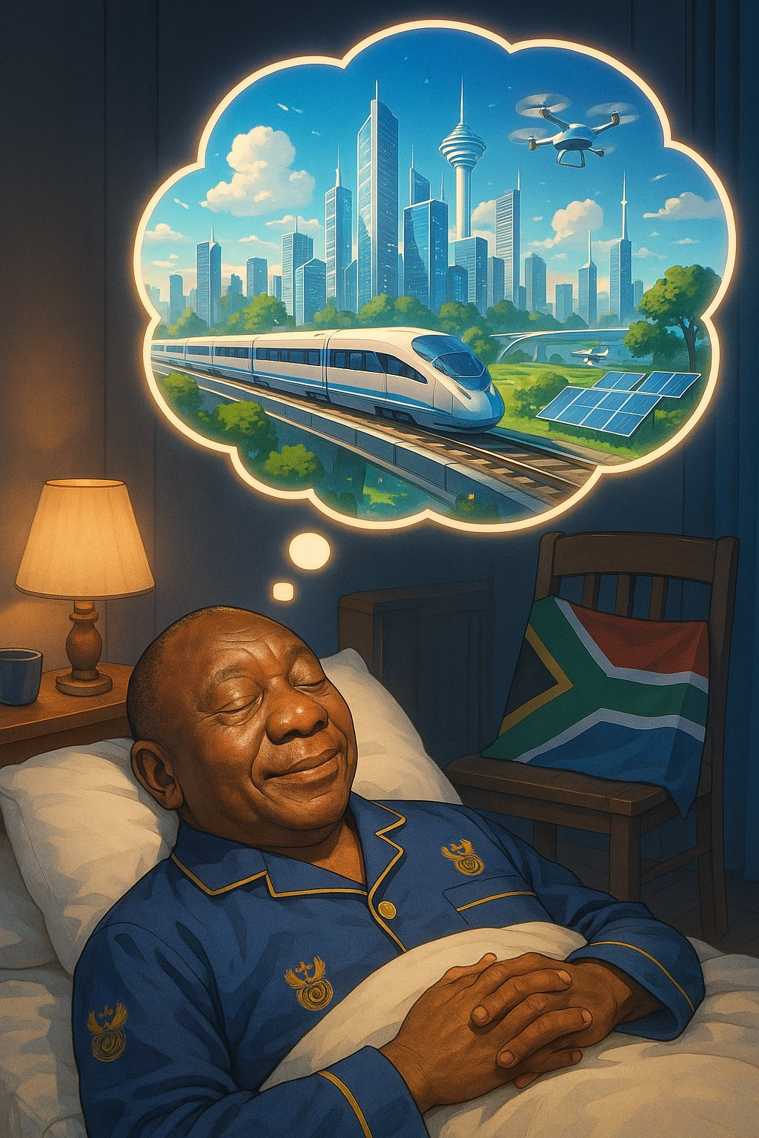

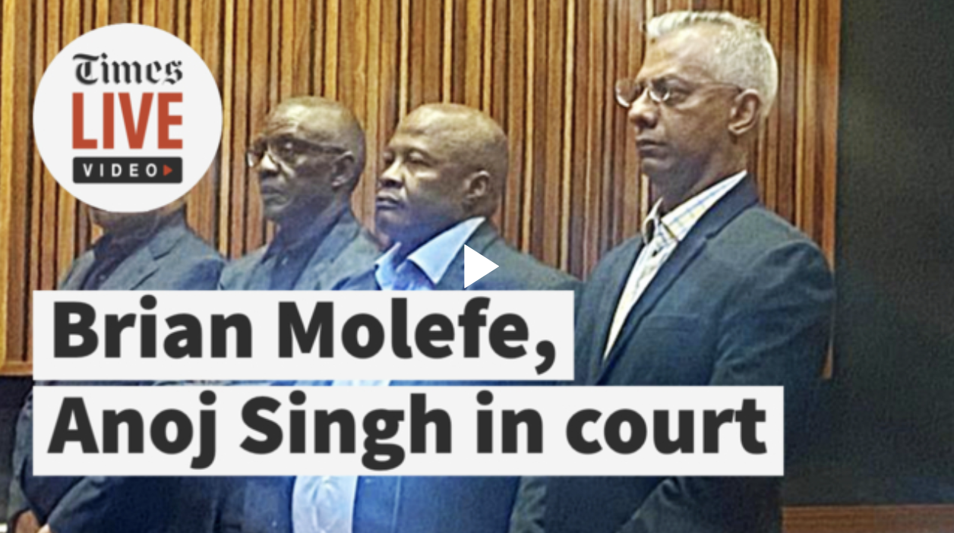
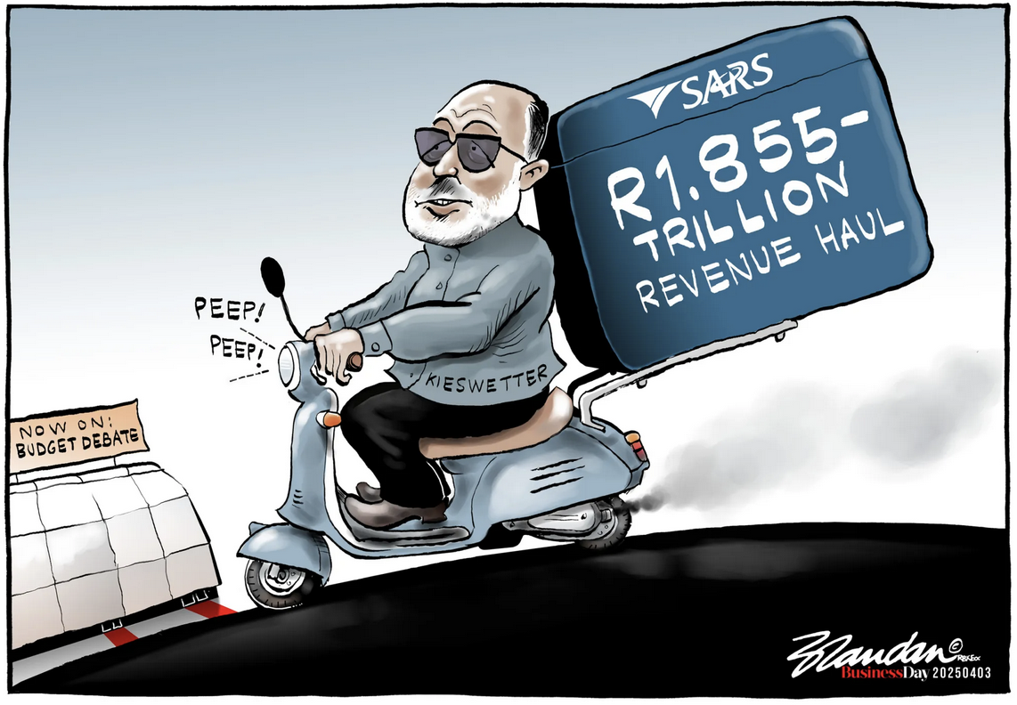

Slide 71

HAIL THE COMMISSIONERS!

Slide 72

HAIL THE CHIEF

Slide 73


HAIL THE BUSINESS-GOVT COLLABORATION

Slide 74
THANK YOU

