Slide 1



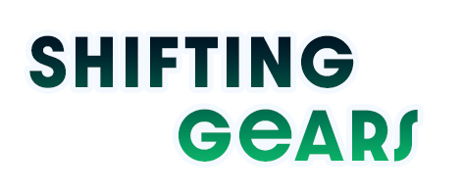


Slide 2

SHIFTING GEARS
WITHOUT STALLING
The Future of Wage Negotiations in
Road Freight & Logistics Industry
Magretia Brown-Engelbrecht
Director ADR Hub (Pty) Ltd
RFA Official

Slide 3

Why This Conversation Matters
THE ROAD AHEAD
Economic challenges
Lack of growth, narrow margins
Fuel volatility
Unpredictable cost structures for operators in current climate
Regulatory shifts
New compliance demands reshaping operational requirements
Organised Labour
Representivity
Foreign driver tensions
Immigration enforcement in flux
Collective bargaining is at a crossroads.
Notes:
Low growth, high inflation volatility
Fuel price instability driving unpredictable costs
BCEA amendments, AARTO, TES scrutiny
Political uncertainty shaping labour expectations / New membership requirements (AI generation)
Enforcement debates and impact on cross-border relations

Slide 4
STATE OF COLLECTIVE BARGAINING
STRENGTHS
WEAKNESSES
Established structures
Predictability & consistency
Industry-wide standards
Relief from plant-level bargaining
Slow to adapt
One-size-fits-all approach
Enforcement challenges
Lack of plant level bargaining?

Slide 5
WHAT 2026 UNION DEMANDS SIGNAL
Structural reform
Unresolved issues
Beyond just wage increases
“The whole shebang” – first time in years
DriveCam, Owner-driver, EBU grading and minimum
Benefits focus
Long-term deal
Medical insurance, minimum wages
Multi-year agreements with inflation reopeners

Slide 6
WHAT MUST CHANGE
Blueprint for a Modernised System
Multi-Year Agreements?
Inflation, fuel indices, regulatory triggers
Sector-Specific Flexibility
Courier / CIT / l Furniture Removal / Long-distance /Abnormal
Scope of the NBCRFLI
All vehicles on the road vs goods for gain
Technological development
What about our people?
Negotiating on a sliding scale
Negotiate issues based on representivity

Slide 7
SHIFTING GEARS WITHOUT STALLING
Recognise pressures on both sides
Modernise outdated frameworks and empower employees
Negotiate with purpose to employees
Build for growth, safety & stability
Prepare! Prepare! Prepare!
Collective bargaining is evolving — and so must we.

Slide 8
The future doesn’t
arrive fully formed -
it’s negotiated into existence.
Thank you

