Slide 1
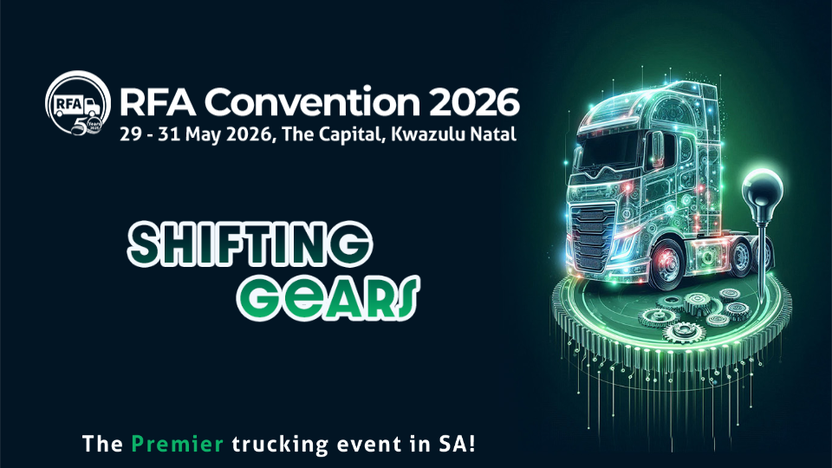
Preparing your transport business for a sustainable smarter future – Liesl De Wet

Slide 2
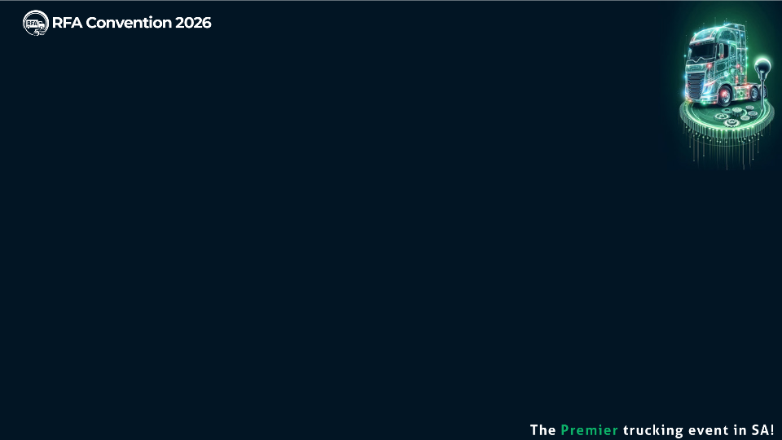

The Future in One Minute
Notes:
South Africa is the largest emitter in Africa, accounting for half the continent’s collective emissions, human rights groups have argued that South Africa’s fair share of responsibility towards the climate crisis should be much higher than other emerging markets, which are less responsible for greenhouse gas emissions.
Business is trying to unpack what this means exactly
NBI have launched with other government partners a transport just transition working group
South Africa’s transition risks are relatively big compared to other developing countries as a result of its over-reliance on fossil fuel energy, like coal.
According to economists, the risks include stranded fossil assets, job losses in fossil fuel sectors as well as a drop in global demand for coal.

Slide 3
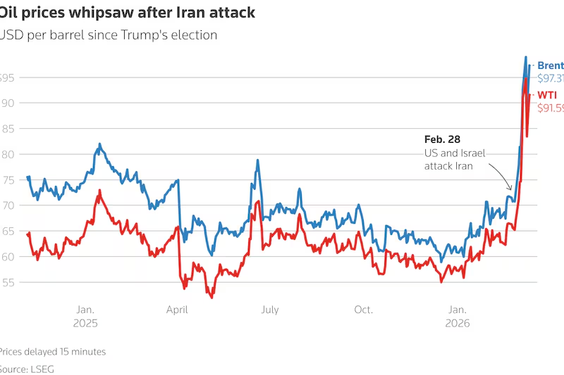
How sustainable transport business builds resilience in an ever changing world
Inaction is now the highest-risk strategy
Fuel costs are volatile efficiency = survival
Geo political environment is unstable
Notes:
South Africa is the largest emitter in Africa, accounting for half the continent’s collective emissions, human rights groups have argued that South Africa’s fair share of responsibility towards the climate crisis should be much higher than other emerging markets, which are less responsible for greenhouse gas emissions.
Business is trying to unpack what this means exactly
NBI have launched with other government partners a transport just transition working group
South Africa’s transition risks are relatively big compared to other developing countries as a result of its over-reliance on fossil fuel energy, like coal.
According to economists, the risks include stranded fossil assets, job losses in fossil fuel sectors as well as a drop in global demand for coal.

Slide 4
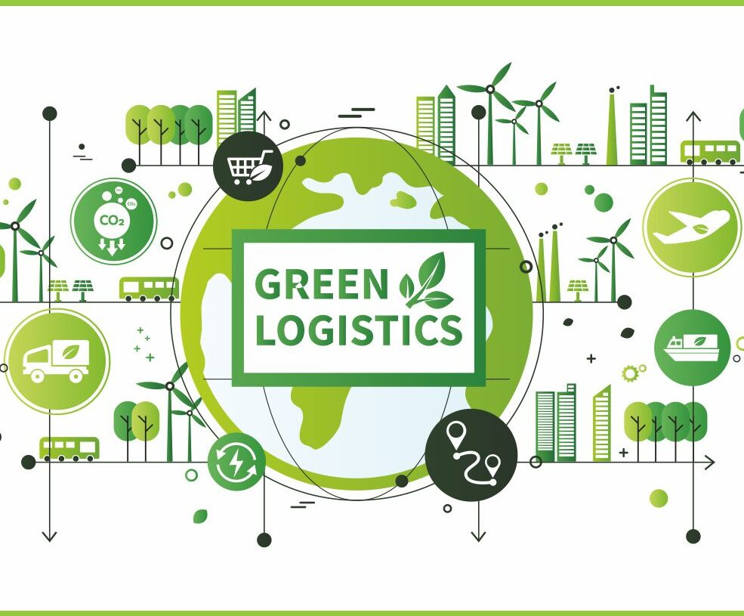
How sustainable transport business builds resilience in an ever changing world
Global Customers focus on low‑carbon logistics
Transport is a material impact in supply chains
Regulation as ESG pressure are increasing
Notes:
South Africa is the largest emitter in Africa, accounting for half the continent’s collective emissions, human rights groups have argued that South Africa’s fair share of responsibility towards the climate crisis should be much higher than other emerging markets, which are less responsible for greenhouse gas emissions.
Business is trying to unpack what this means exactly
NBI have launched with other government partners a transport just transition working group
South Africa’s transition risks are relatively big compared to other developing countries as a result of its over-reliance on fossil fuel energy, like coal.
According to economists, the risks include stranded fossil assets, job losses in fossil fuel sectors as well as a drop in global demand for coal.

Slide 5

How sustainable transport business builds resilience in an ever changing world
Climate risk is directly impacting operations
Technology is rapidly reshaping the industry
Notes:
South Africa is the largest emitter in Africa, accounting for half the continent’s collective emissions, human rights groups have argued that South Africa’s fair share of responsibility towards the climate crisis should be much higher than other emerging markets, which are less responsible for greenhouse gas emissions.
Business is trying to unpack what this means exactly
NBI have launched with other government partners a transport just transition working group
South Africa’s transition risks are relatively big compared to other developing countries as a result of its over-reliance on fossil fuel energy, like coal.
According to economists, the risks include stranded fossil assets, job losses in fossil fuel sectors as well as a drop in global demand for coal.

Slide 6
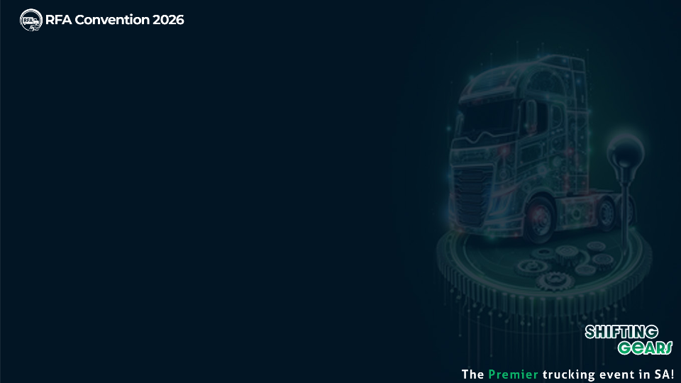

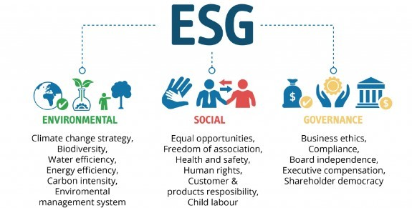
Sustainability and ESG
ESG is the measurable
Sustainability is the Vision
Notes:
Sustainability is not one big leap—it’s a series of smart gear changes.

Slide 7
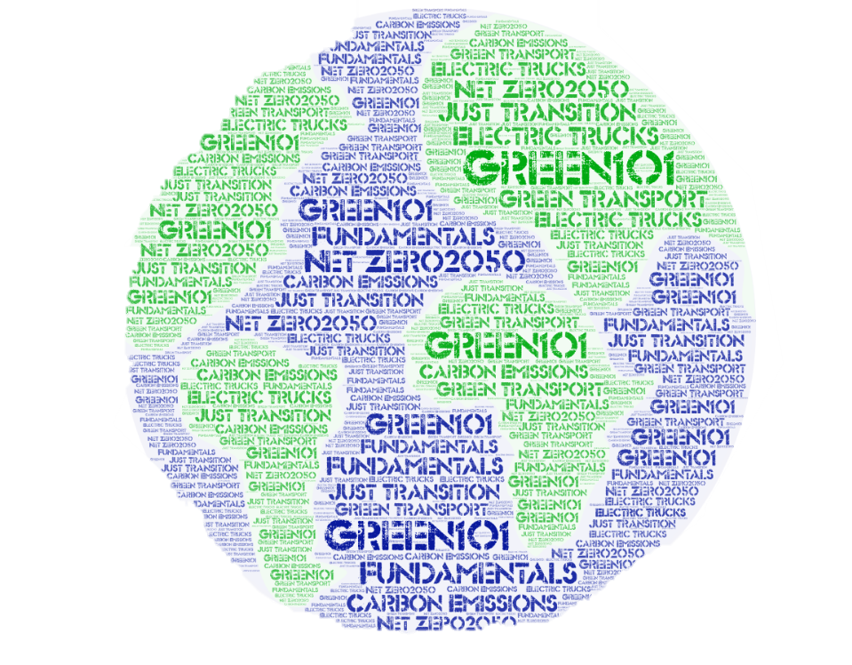
Industry needs a step change to reach NetZero ambition targets by 2050….
Fuel greening
Technology shift
Modal shift models
Vehicle & trailer maintenance
Adherence to the road traffic act
Utilization of vehicle
Just transition
Transition challenges include:
Need for policy support
High EV costs (commercialization)
Infrastructure disparities
Energy insecurity impact
Notes:
Energy Insecurity Impact: Loadshedding and unstable energy supply reduce electric vehicle infrastructure reliability and deter investments in South Africa.
High EV Costs: The high upfront cost and absence of a strong second-hand market limit electric vehicle accessibility for consumers and small businesses.
Infrastructure Disparities: Rural and secondary municipalities lack adequate charging infrastructure, creating unequal access to green mobility solutions.
Need for Policy Support: Targeted policies, partnerships, and community involvement are crucial to overcome challenges and foster sustainable transport development.
South Africa is the largest emitter in Africa, accounting for half the continent’s collective emissions, human rights groups have argued that South Africa’s fair share of responsibility towards the climate crisis should be much higher than other emerging markets, which are less responsible for greenhouse gas emissions.
Business is trying to unpack what this means exactly
NBI have launched with other government partners a transport just transition working group
South Africa’s transition risks are relatively big compared to other developing countries as a result of its over-reliance on fossil fuel energy, like coal.
According to economists, the risks include stranded fossil assets, job losses in fossil fuel sectors as well as a drop in global demand for coal.

Slide 8
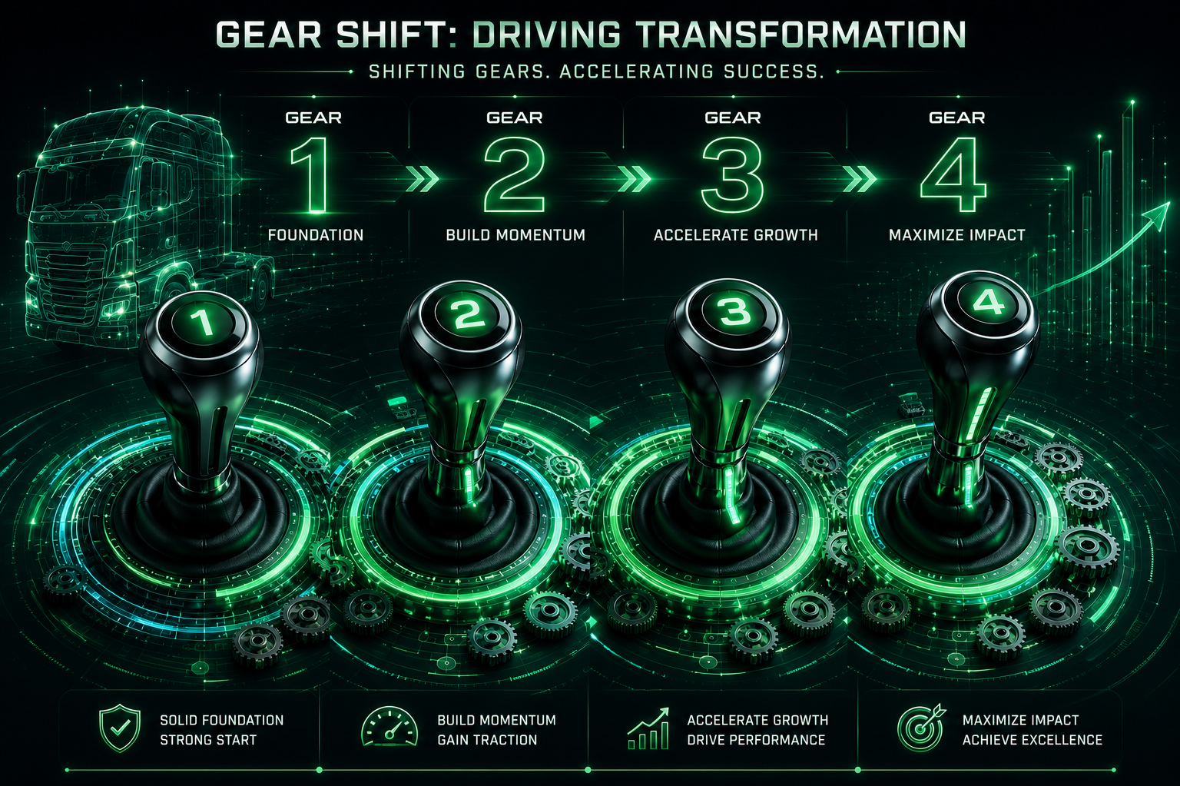
Notes:
Sustainability is not one big leap—it’s a series of smart gear changes.

Slide 9

The 4 Gears of a Smarter Transport Business
Gear 1: Foundation: Visibility & Measurement
Data, data everywhere…..but what is it telling you, and are you paying attention?
Fuel, emissions, maintenance, route efficiency, getting the fundamentals right….
“You can’t manage what you don’t measure”

Slide 10
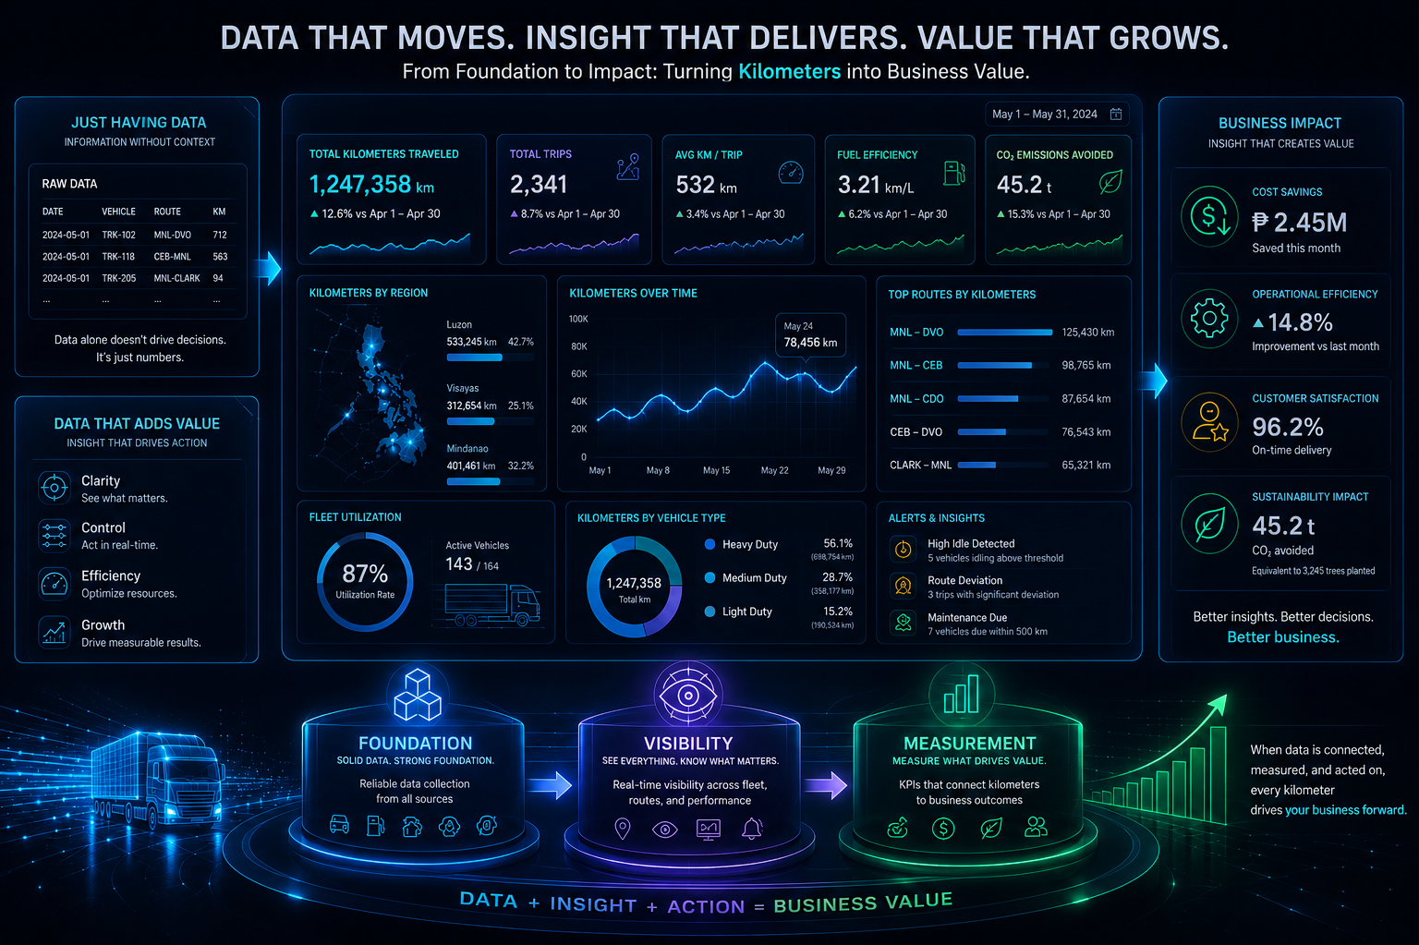

Slide 11

The 4 Gears of a Smarter Transport Business
Gear 2: Build momentum = Operational Efficiency
Executive support and leadership
Driver behaviour and training
Route optimisation
Preventative maintenance
Tyre and load optimisation

Slide 12

The 4 Gears of a Smarter Transport Business
Gear 3: Accelerate growth = Technology and Innovation
Telematics and data-driven decisions
Alternative fuels and transitional technologies
Digital fleet management

Slide 13

The 4 Gears of a Smarter Transport Business
Gear 4: Maximise impact = Future proof and transition strategy
EV future: are you ready
  Skills required
  All about the charging stations
  Battery technology
  Energy requirements
Hydrogen Fuel cell technology advancements

Slide 14
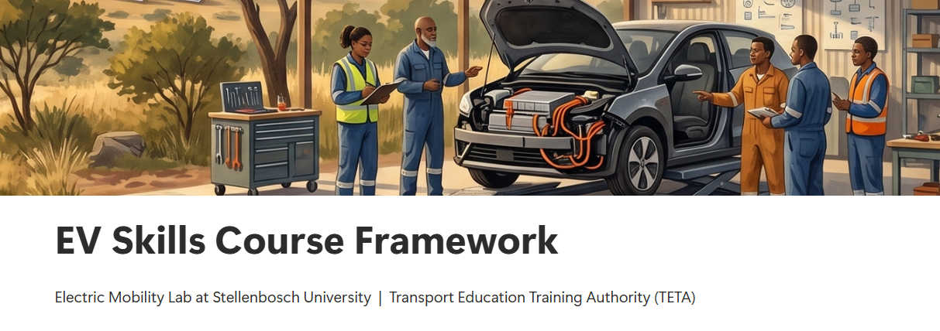
Gear 4: Maximise impact = Future proof and transition strategy
Stellenbosch University in partnership with TETA, the Transport Education and Training Authority in South Africa.
developed an EV Skills training framework for South Africa.
Notes:
The framework comprises 13 proposed course modules and 13 key roles linked to these modules.
Launching 2027

Slide 15
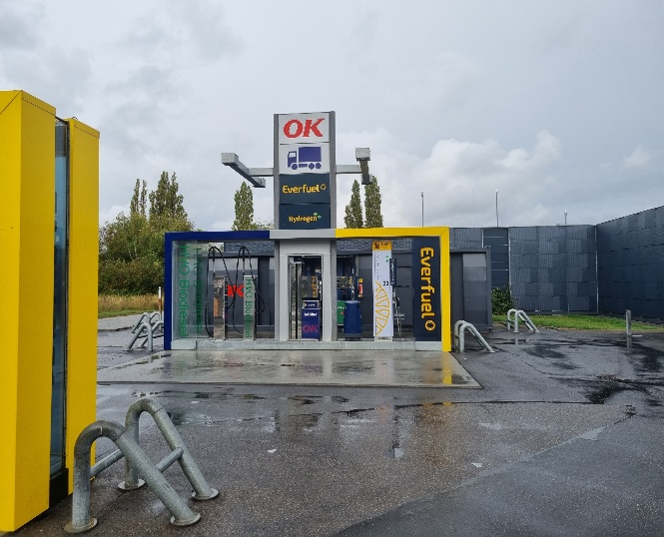
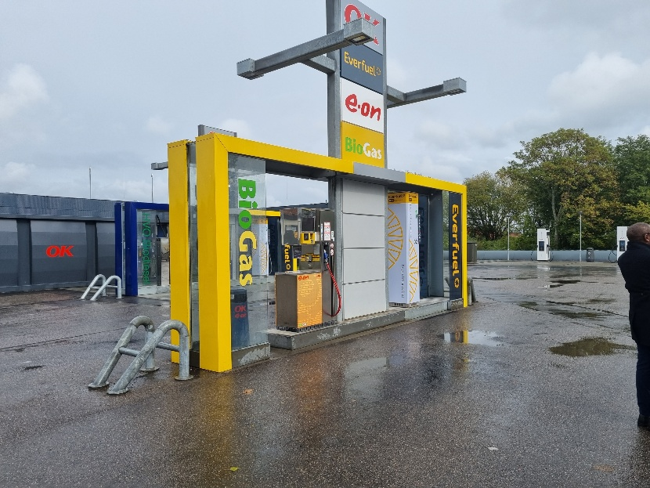
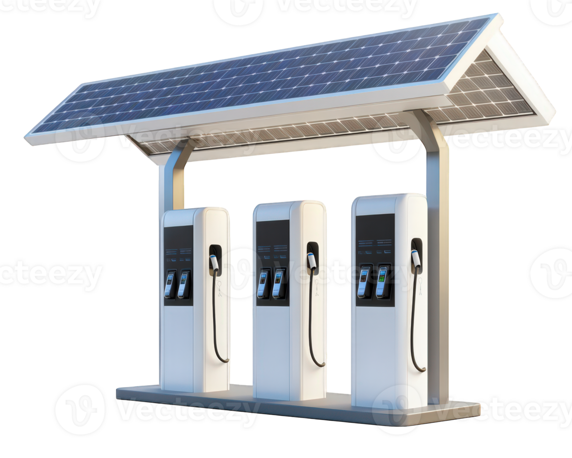
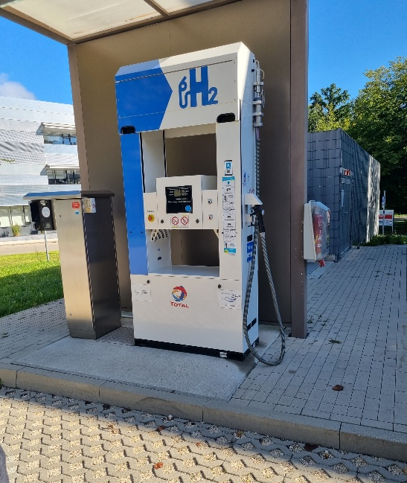
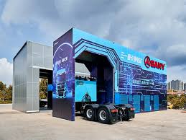
Gear 4: Maximise impact = Future proof and transition strategy

Slide 16
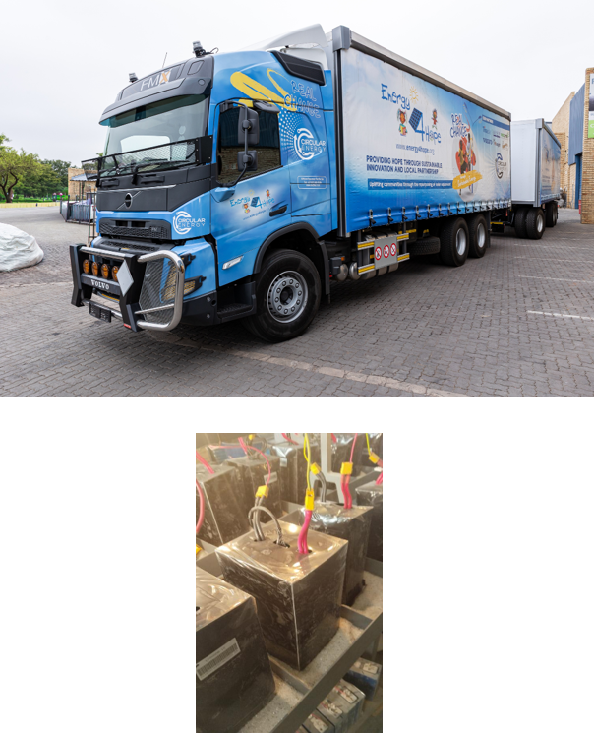
Gear 4: Maximise impact = Future proof and transition strategy
EV RE-USE - ENERGY 4 HOPE
  Energy 4 Hope is a non-profit company established by Circular Energy dedicated to transforming lives by providing sustainable energy solutions to communities in need.
  In South Africa, many solar farms are replacing solar PV modules and energy storage systems that no longer meet performance standards.
  Circular Energy is creating a safety and performance testing methodology for reused solar PV modules and EV batteries.

Slide 17
The 4 Gears of a Smarter Transport Business
Gear 4: Maximise impact = Future proof and transition strategy
Regulation readiness
Customer collaboration
Industry collaboration via RFA initiatives, be part of the conversation

Slide 18

