Slide 1


The Road Freight Association
Convention 2026
CEO Address
29 May 2026

Slide 2
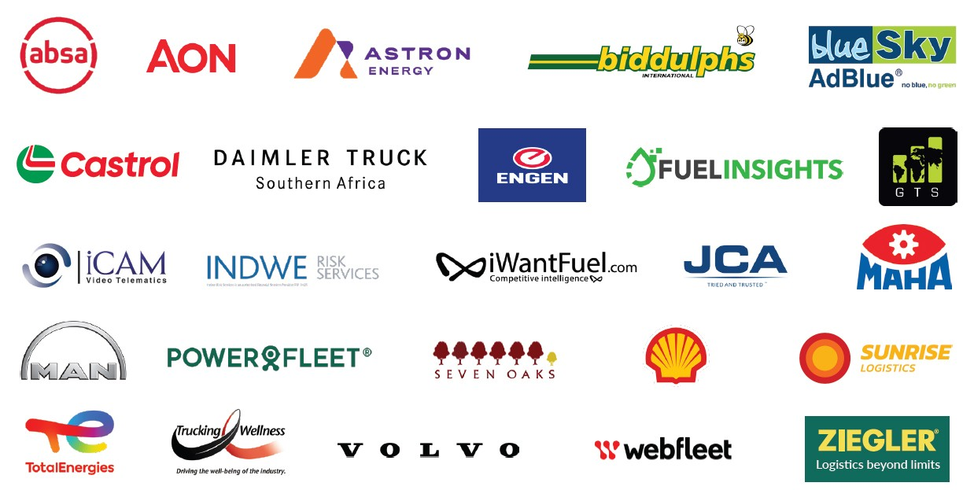

To all our Sponsors – Thank You

Slide 3

Address Overview
The Year that was: 2025
2026: As it is Now
2027: Crystal Ball
Sustainability through data
Reducing risk exposure to AARTO
Crime Realities
Crime – possible solutions
Your Partner – the Association
Stay Connected, Informed & Involved

Slide 4
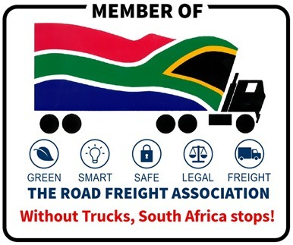
The Year that was: 2025
Membership: increase of 14%
Labour: another year of peace
Events: 14 well attended engagements
Finance: Sound footing
Big 04 Challenges
Undocumented Foreigners – patience has run out
Ports – queues, terminal congestion, rail decline
Crime – no deterrent or pro-active activity
Rates – huge pressure on operating margins

Slide 5

2026: as it is Now
DoEL: Employment Equity (EE) in place
SARS Customs: Faster movement with AEO and SmartBorders
Ports: new equipment, private players appointed
DoT: B-BBEE impact discussions still ongoing
Crime: SAPS still under heavy pressure to turn the tide
Rail: private operators starting to come on board
Labour: mandating sessions underway for new agreement 2027
Alternative energy: new competitive technology from China

Slide 6

2027: Crystal Ball
Challenges
DoEL: harsh application of EE implementation / quotas
DoT: no implementation of fleet operator registration
ATDF-SA: return to violent protests
Transnet: severe competition from private operators
Labour: more militant approach to gain all demands
Alternative energy: affordable & sustainable alternative options
B-BBEE: drive to apply a vindictive scorecard (to correct lengthy delays)
Crime: increase due to socio economic pressures
AARTO: irrational processes driving cost and fleet immobilisation

Slide 7

2027: Crystal Ball
Opportunities
GNU: refocus on development and service delivery
Economy: rating agency upgrades = greater foreign investment
AcFTA: growing regional markets = supply & demand logistics
Freight cities: developing logistics infrastructure & growth
Ports: private players driving healthy competition
Rail: real private operations pushing competition
Sustainable margins: removal of non-compliant players

Slide 8
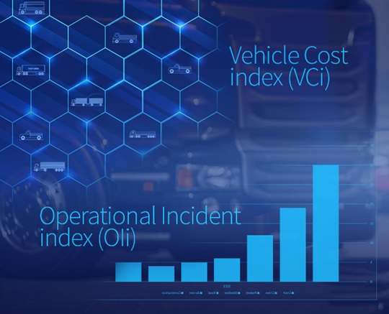
Sustainability through data
Policy support: protect your business
VCi: monthly transport cost index
Oli: monthly incident index
Webinars: Tools for Transporters (quick-byte information)
Development: technology / energy alternatives
Expert assistance: prosecution / government
Customer assurance: Core Code provides quality standards

Slide 9
Reducing risk exposure to AARTO
Road Transport Quality System (RTQS): Chapter VI of the NRTA requires operators to manage driver behavior, vehicle maintenance, and compliance with traffic regulations and reduce crashes thereby improving overall efficiency
Preventative Maintenance Programs: Regular inspection / AI monitoring systems / maintenance of vehicles are critical in avoiding incidents caused by mechanical failure
Rigorous Driver Screening: Thorough driver background checks, licence verification
Continuous Driver Training: Ongoing safety & skills training, AI driver support ensures that drivers are qualified and compliant with safety protocols

Slide 10
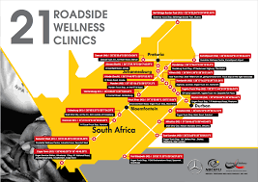
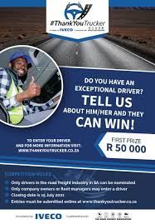
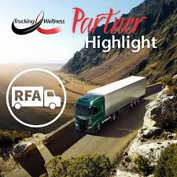

Driver Safety

Slide 11
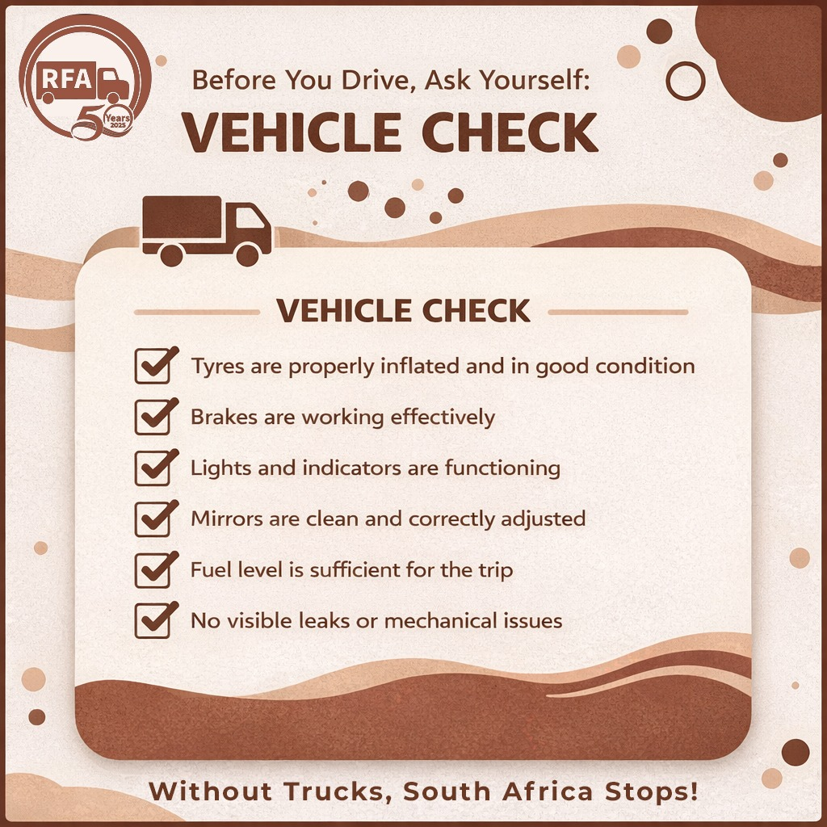
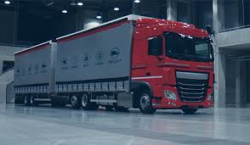
Vehicle Safety

Slide 12
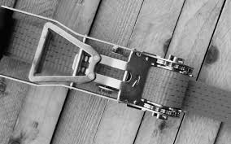
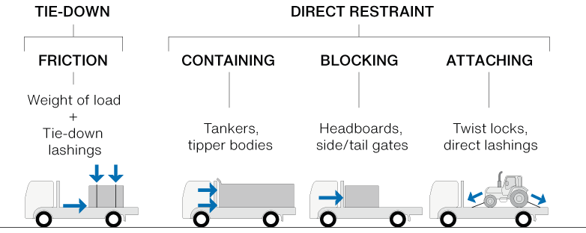
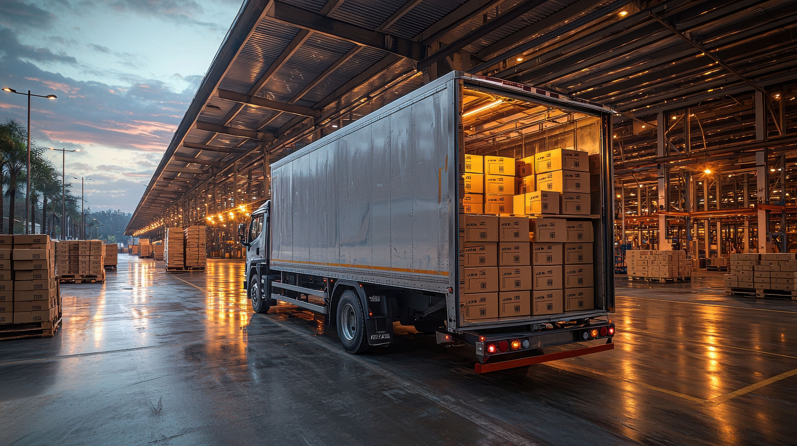

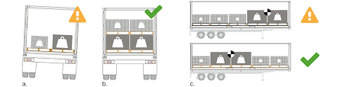
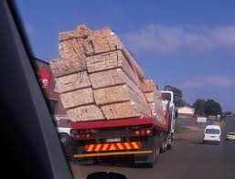
Load Management
© NHVR

Slide 13
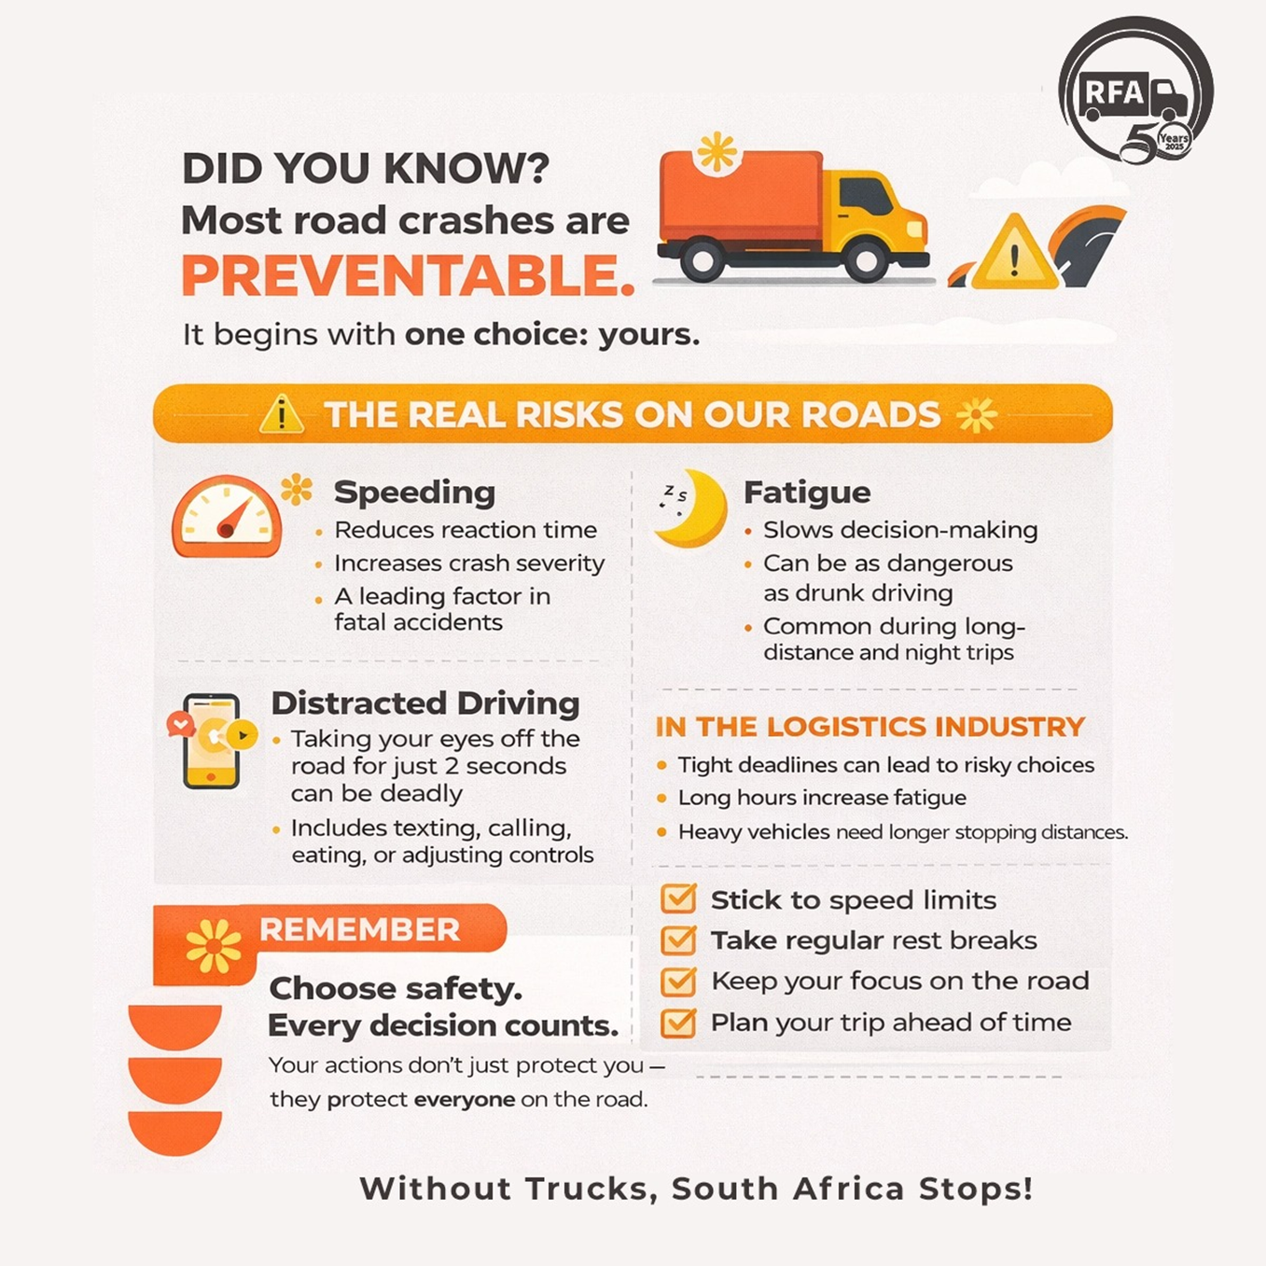
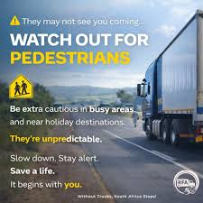

Road Safety

Slide 14
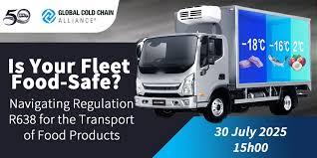
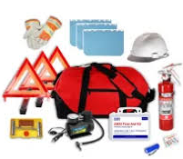
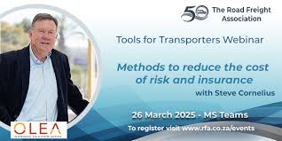
Equipment Safety

Slide 15

Crime Realities
High-jacking (vehicle / load / driver)
Cross-border (loads / destinations / guarantees / delivery)
Authority (corruption / extortion)
Criminal syndicates (mafias / industrial espionage / cabals)
Opportunistic crime
  Embedded crime

Slide 16
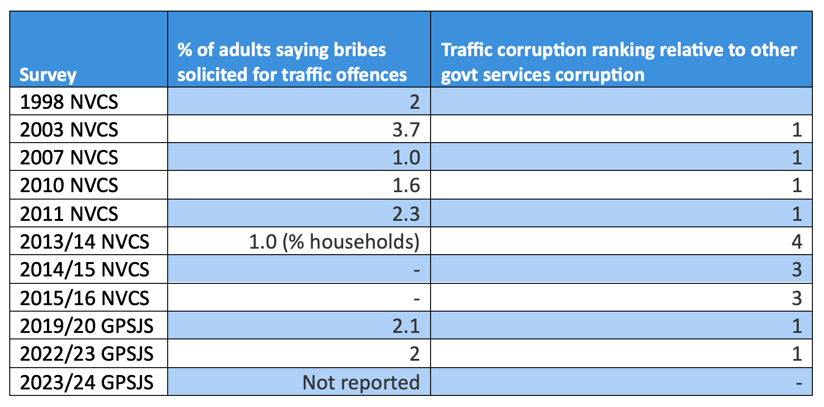
Traffic Authorities
Daily battle with corruption / intimidation / coercion /
Basic policing tasks ignored in favour of revenue generation
Grossly incorrect charges (notices) compiled
Confiscation of discs / licences / permits to force payment of bribes
Source: NVCS - National Victims of Crime Survey; GPSJS - Governance, Public Safety and Justice Survey. Surveys from 2010 onwards conducted by Stats SA

Slide 17
Criminal Syndicates
Hijacking Volumes: SAPS reports estimated 30-35 truck hijackings occur p/week. 420 truck hijackings in the second quarter of 2025
Financial Impact: 18-month analysis (2022) revealed 2,670 cargo theft incidents cost roughly R577 mil but only 3.4% of victims share financials
Targeted Commodities: Fast-moving consumer goods (FMCG) - 81% of reported incidents (alcohol, food, clothing, and electronics
Business Risk: sophisticated and coordinated criminal networks also target DCTs / warehouses

Slide 18
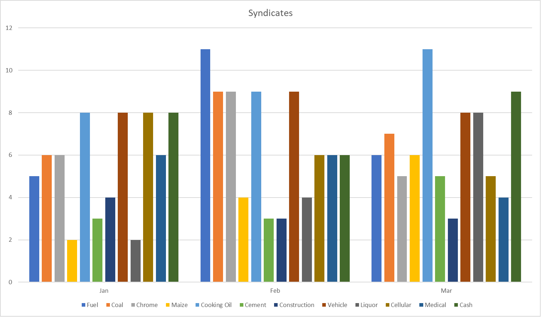
Criminal Syndicates
© RFA 2026
© RFA 2026

Slide 19
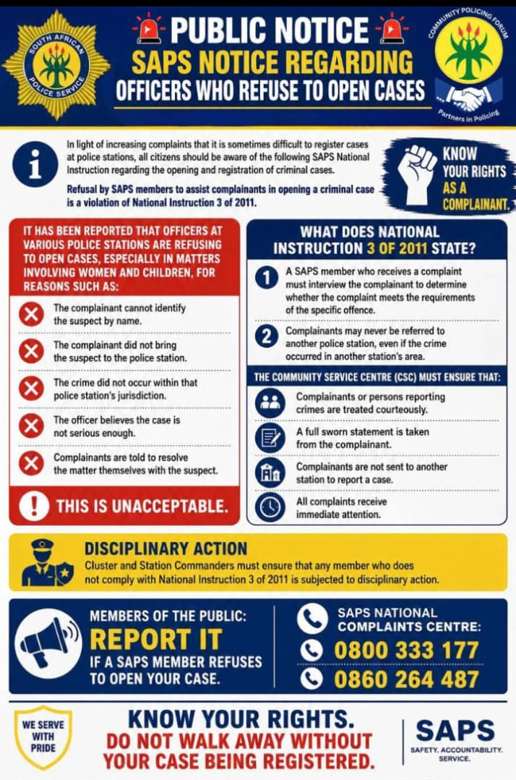
SAPS Commitment to ending Crime

Slide 20
Opportunistic crime
High Volume of Incidents: over 40,000 incidents impacting supply chains reported in 2024/25 period (SAPS)
Provincial Hotspots: Gauteng accounts for 56% to 64% of vehicle-related crime. N2 corridor towards E Cape experiencing increase
E-commerce Expansion: online shopping has led to vast courier vehicle movement creating smaller, more frequent targets
Economic Conditions: High unemployment fuels opportunistic looting
Loadshedding: Poor lighting, inoperable security (cameras / fencing)

Slide 21
Embedded Crime
Insider Collusion: Internal collusion (driver involvement) is a recognized challenge, with 2.7% of incidents explicitly cited as internal
Modes of Attack: Criminal employees use sophisticated methods, including "blue light gangs" posing as police, GPS jamming, and falsified documentation to steal cargo
Facility Theft: Ports and bonded warehouses are high-risk areas for drugs and smuggled goods

Slide 22
Crime – Possible Solutions
Real-time GPS Tracking & Telematics: Continuous vehicle tracking using telematics to monitor driving patterns (acceleration, braking, speed) allows for immediate identification of risky behavior
AI-Powered Video Surveillance: Cameras with AI can monitor driver alertness, detect fatigue, and provide real-time footage of the cabin and road, which is essential for investigating incidents and enhancing safety
Vehicle Security and Perimeter Control: advanced, cloud-based security systems for warehouses and vehicles, such as automated license plate recognition, smart access control, and panic buttons, helps prevent unauthorized access
IoT and Sensor Technology: Temperature sensors / smart locks ensure the security and integrity of goods in transit

Slide 23

The RFA – Your Parter in mitigating risk
IoT / Collaborative Security Efforts: members work together to pool resources to enhance surveillance and security measures, incident reporting, advance warning through common platforms tailored to develop solutions / programmes to address issues
Route Optimization: access to analytical data to identify safer, more efficient routes
Risk Management: access to data to avoid high-crime areas and risky routes
Generic and specific solutions: training and advice from affiliated members (across various products and services) to assist with tailored and bespoke solutions to specific or unique challenges experienced by a member (or members)
Without Trucks, South Africa Stops!

Slide 24
The Road Freight Association (RFA)
provides a platform for stakeholders in the road freight logistics industry to engage, collaborate & resolve challenges
relies on the engagement of its members to make their challenges, issues and concerns heard
collates the perspectives / experiences of its members relating to opportunities, threats and challenges and uses those as the foundation to interact with, educate and lobby various government authorities at national, provincial and local level, as well as the broader financial and public regarding the road freight and logistics industry.

Slide 25



Stay connected, informed & involved
Join & follow the conversation
Get the communications, updates & reminders
Give your input / contribute to the conversation
Watch for critical notes & warnings
Utilise your membership benefits
Check out events: https://rfa.co.za/SA/events/

Slide 26


The acknowledged & respected voice of the road freight industry
Creating social partnerships with government
Promoting a regulatory environment which supports growth in the industry
Driving professionalism, excellence and safety in the road freight industry
Without Trucks, South Africa Stops!

